Slide 1
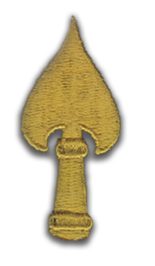
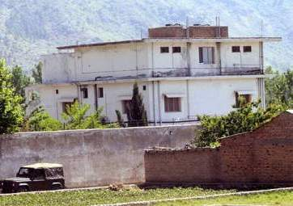
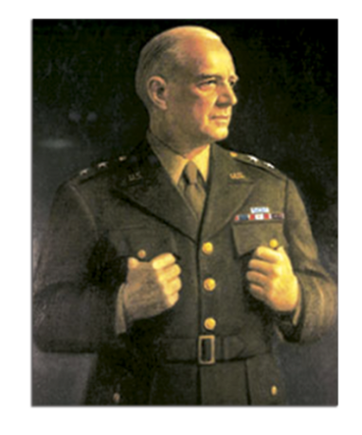
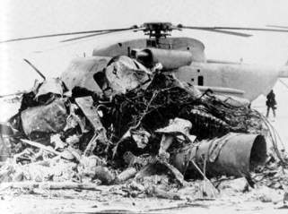
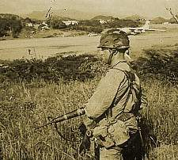
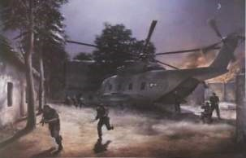
U.S. Special Operations Command
The Nexus of Strategy and Innovation

Slide 2
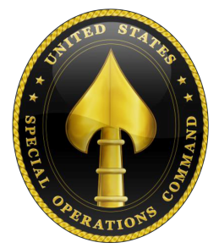
Purpose and Agenda
Purpose: To provide information on U.S. Special Operations Command, the Donovan Strategy and Innovation Group, and describe our emerging view of the future
Agenda:
What are Special Operations?
Who are We?
What is Our Emerging View?

Slide 3
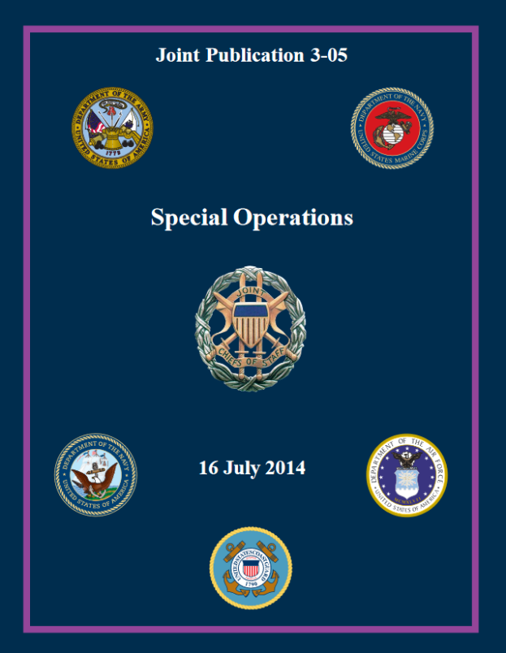
What are Special Operations?
Operations requiring unique modes of employment, tactical techniques, equipment and training often conducted in hostile, denied, or politically sensitive environments and characterized by one or more of the following:
Time sensitive
Clandestine
Low visibility
Conducted with/through indigenous forces
Requiring
Regional expertise
A high degree of risk

Slide 4
USSOCOM Mission
“USSOCOM develops and employs fully capable Special Operations Forces to conduct global special operations and activities as part of the Joint Force to support persistent, networked, and distributed Global Combatant Command operations and campaigns against state and non-state actors, to protect and advance U.S. policies and objectives.”
- 2018 Campaign Plan for Global Special Operations

Slide 5
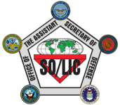
National Defense Authorization Act of 1986
President of
the United
States
Secretary
of Defense
Under Secretary
of Defense (POLICY)
U.S. Special Operations
Command
Assistant Secretary
of Defense (Special Operations
Low-Intensity Conflict)

Slide 6
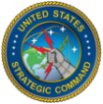
A Unique Command
A Combatant Command
…with legislated Military
Department-like authorities
Organize, train, equip SOF
Develop SOF strategy, doctrine, and tactics
Program and budget for SOF
Procure SOF-peculiar equipment
Monitor management of SOF personnel
Ensure interoperability
Conduct internal audits
Command of all SOF
Synchronize planning for global operations against terrorist networks
Deploy SOF to support GCCs
As directed, conduct operations globally
Plan & execute pre-crisis activities

Slide 7
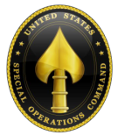
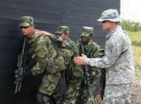
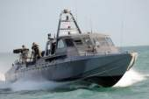
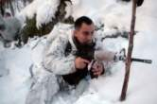
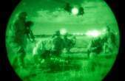
The SOF Enterprise
U.S. Special Operations
Command
United States Army
Special Operations
Command
(USASOC)
Naval Special
Warfare Command
(NAVSPECWARCOM)
Air Force
Special Operations
Command
(AFSOC)
Marine Corps
Special Operations
Command
(MARSOC)
Joint Special
Operations
Command (JSOC)
FT BRAGG, NC
SPECIAL FORCES
RANGERS
AVIATION
MISO
CIVIL AFFAIRS
JFK SPECIAL
WARFARE CENTER
NAB CORONADO, CA
SEAL TEAMS
SPECIAL BOAT TEAMS
SEAL DELIVERY
VEHICLE TEAMS
NAVAL SPECIAL
WARFARE CENTER
HURLBURT AFB, FL
AVIATION - FIXED WING
& VERTICAL LIFT
SPECIAL TACTICS
AVIATION FID
ISR/PED
AIR FORCE SPECIAL
OPERATIONS SCHOOL
CAMP LEJUENE, NC
MARINE SPECIAL
OPERATIONS
COMPANIES
MARINE SPECIAL
OPERATIONS
ADVISORY GROUP
MARINE SPECIAL
OPERATIONS
SUPPORT GROUP
MARINE SPECIAL
OPERATIONS SCHOOL
FT BRAGG, NC
JOINT STANDING
DEVELOPMENT,
TRAINING
AND EXERCISES

Slide 8
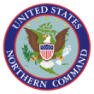
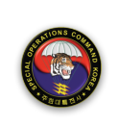
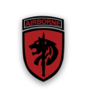
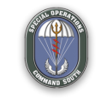
Theater Special Operations Commands
USNORTHCOM
USEUCOM
SOCEUR
Stuttgart, Germany
SOCNORTH
USAFRICOM
USPACOM
SOCKOR
Camp Kim, Seoul, Korea
USSOUTHCOM
SOCCENT
MacDill AFB, Florida
USPACOM
SOCAFRICA
Stuttgart, Germany
SOCSOUTH
Homestead ARB, Florida
SOCPAC
Camp Smith, Hawaii

Slide 9
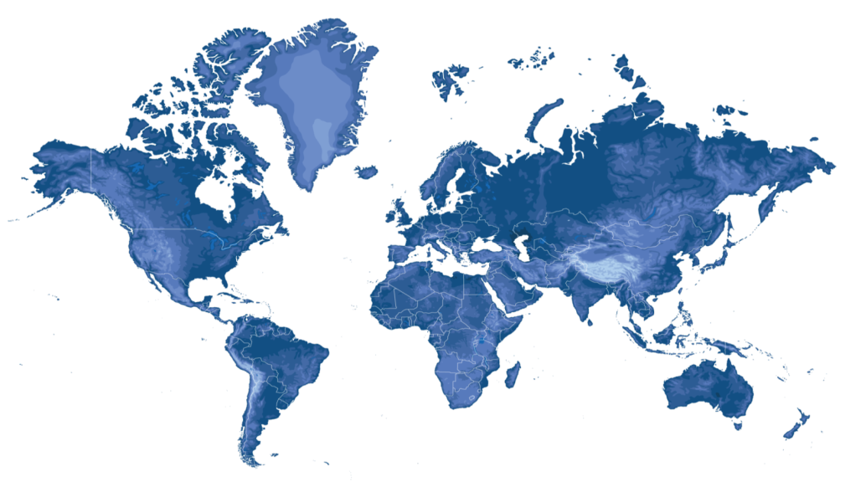
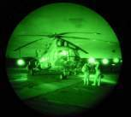
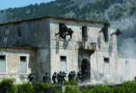
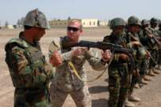
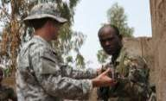
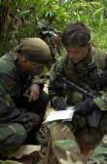
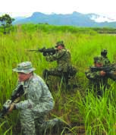
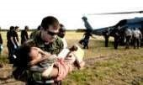
SOF: Small Numbers, Strategic Impact
~77,000 Strong with ~8,000+ forward deployed
Annual presence in ~80 countries
Less than 2% of Department of Defense budget

Slide 10
Our Vision and Mission
Vision
The Donovan Strategy and Innovation Group acts as a catalyst for change and innovation across the Joint SOF enterprise
Mission
We continually develop an understanding of strategic opportunities and challenges; frame strategic approaches; identify capabilities; and integrate recommendations into the Joint SOF enterprise and improve its ability to further national interests across the globe

Slide 11
Our Approach
Core Questions
What are the strategic opportunities and challenges facing the Joint SOF Enterprise?
How can we integrate recommendations into the Joint SOF Enterprise?
How should the Joint SOF enterprise frame its strategic approaches?
Complexity
Change
Conflict
Confusion
Connectivity
Cooperation
Our “Team of Teams”
Joint
Interagency
International
Multinational
Industry
Academia
Non-Governmental
Others
What capabilities does the Joint SOF enterprise require?

Slide 12
The Nexus of Strategy and Innovation
HF
Populations
Sea
Acquisitions
Design Thinking
National Military Strategy
Other Guidance
Domains and Environments
Air
Land
Space
Sustaining Innovation
Road
Mapping
Joint Strategic Campaign Plan
Strategic Guidance
Subsurface
Cyberspace
National Security Strategy
Subterranean
R&D Labs
15-20% Rule
National Defense Strategy
Venture Capital Model
Disruptive
Innovation
Nature of War
Fog, Friction, Chance
Strategy
Innovation
Strategic Theory
People, Government, Military
Innovation Labs
Lean Launchpad
Fear, Honor, Interest
Competition
Open Innovation /Prizes
Character of Conflict
China
Law Enforcement
Breakthrough Innovation
Iran
Research Divisions
Russia
Military
U.S. National Security Challenges
Elements of National Power
Basic Research
North Korea
Mavericks
Diplomacy
Economic
Skunkworks
Violent Extremism
Financial
Academic Partnerships
Journals and Conferences
Information
Intelligence
Satell, G. (2017). The 4 Types of Innovation and the Problems They Solve. Harvard Business Review. Retrieved from https://hbr.org/2017/06/the-4-types-of-innovation-and-the-problems-they-solve

Slide 13
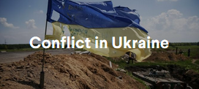
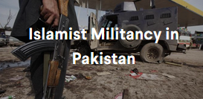
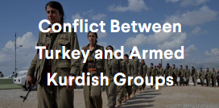
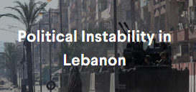
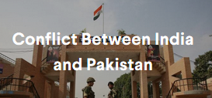
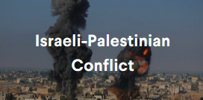
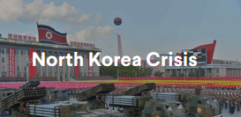
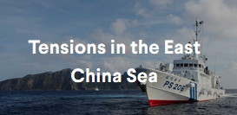
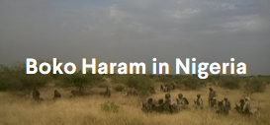
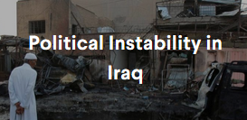
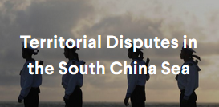
The Problem
Current Conflicts with Critical and Significant Impact on U.S. Interests
CFR Global Conflict Tracker: https://www.cfr.org/interactive/global-conflict-tracker/?category=us

Slide 14
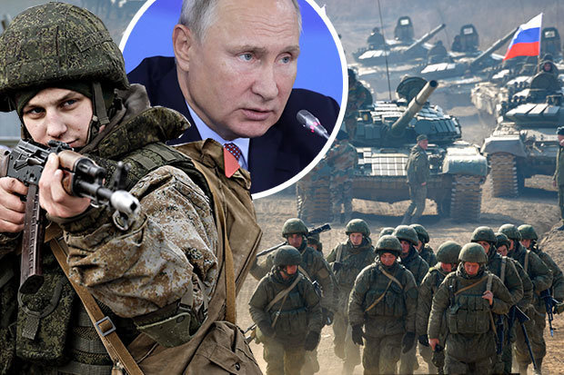
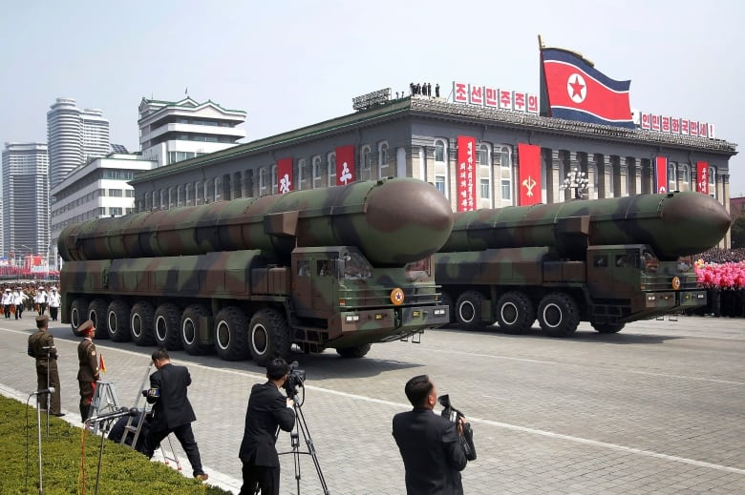
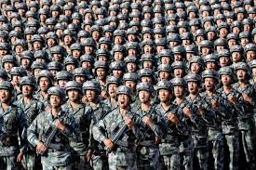
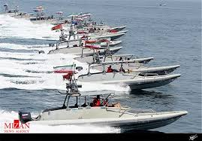
The Need
Global Competition, Regional Instability, and Violent Extremism
Russia
North Korea
Violent Extremists
Iran
China
2018 National Defense Strategy, https://nationalinterest.org/blog/buzz/why-us-military-serious-trouble-36317

Slide 15
Commander’s Vision
SOF Ethics and Culture: Americans have high expectations and utmost confidence in their SOF, Trust is earned and should never be compromised
Support to Combatant Commanders: We will coordinate closely with the other Combatant Commands who serve the Joint Force, to provide integrated approaches and capabilities that enable success
Priorities:
Compete and win for the Nation - Protect our interests and address today's challenges
Preserve and Grow Readiness - The right people, skills, and training to maximize our competitive edge
Innovate for Future Threats - Relentlessly build the competitive advantage
Advance Partnerships - Create opportunities through our unique global understanding and placement
Strengthen our Force and Family - Solemnly commit to the short and long term well-being of our SOF Family
“We will successfully combat VEOs, counter WMD, shape the information environment, and compete in the Great Power arena”

Slide 16
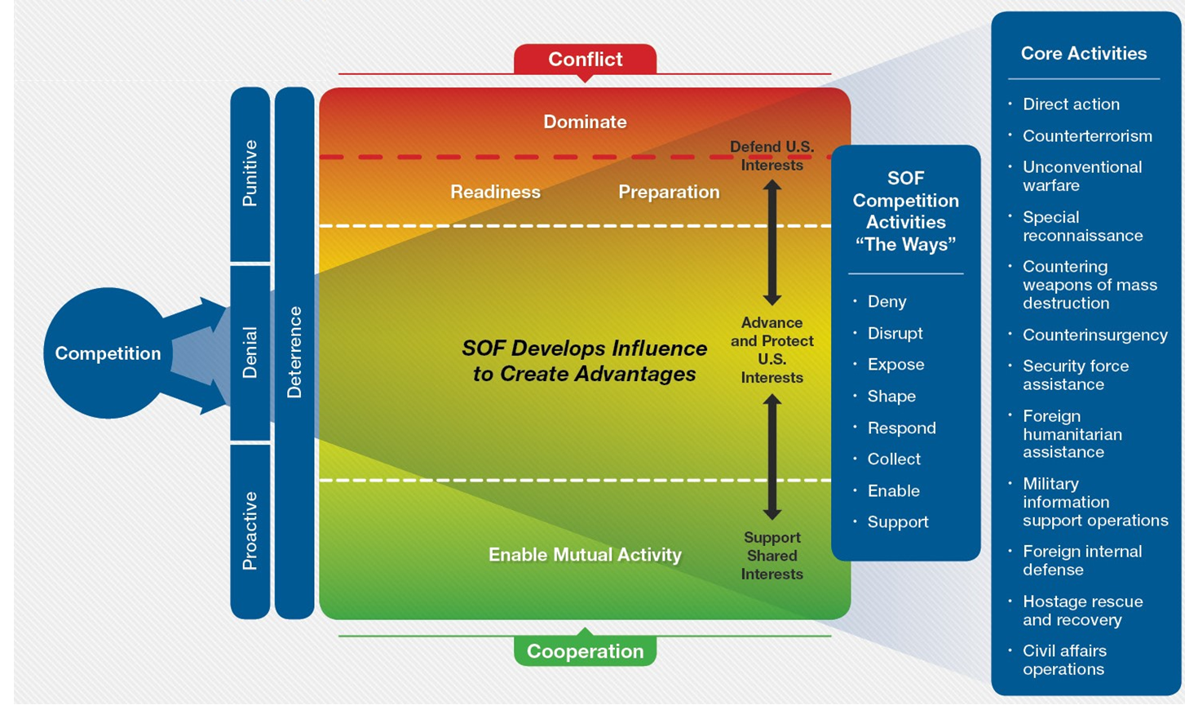
SOF Employment
From Peacetime to War

Slide 17
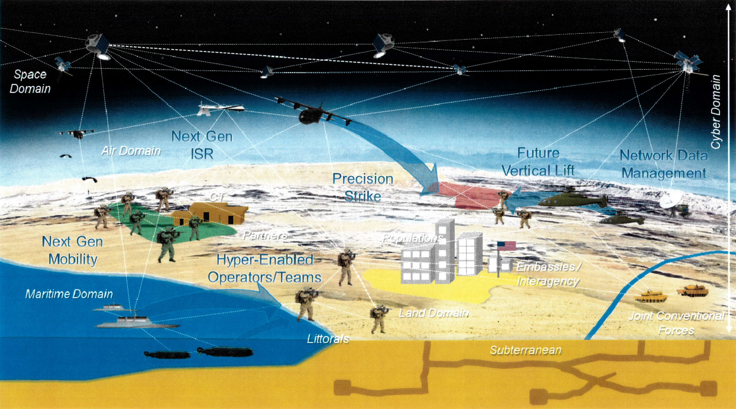
An Emerging Vision of the Future

Slide 18
Action
Join our “Team of Teams”
Google “SOFWERX” → Click “TechWatch” → “Signup”

Slide 19
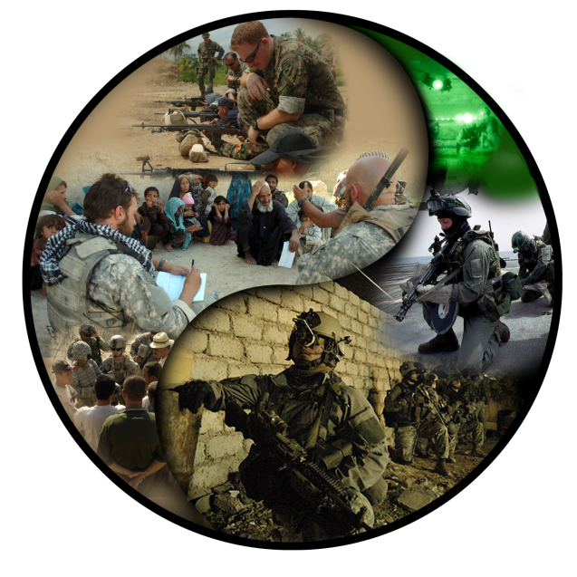
Questions?
“Future SOF must be more lethal, trans-regionally integrated, and effective in contested domains…
…We must field overmatch technologies and tactics that exploit adversary vulnerabilities and negate near-peer competitor advantages”
- General Richard Clarke
Commander, USSOCOM

Slide 20
Backup

Slide 21
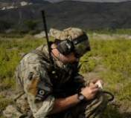
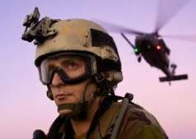
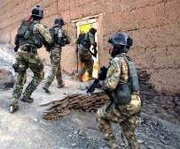
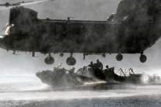
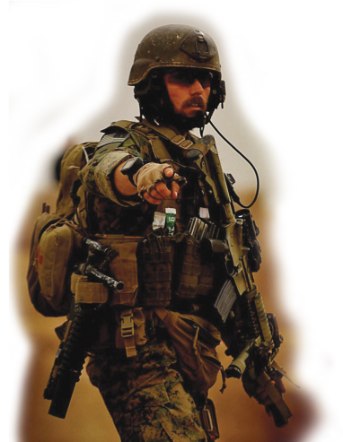
SOF’s Advantage -- Its People
INTEGRITY
COMPETENCE
COURAGE
CREATIVITY
Humans are more important than hardware
Quality is better than quantity
Special Operations Forces cannot be mass produced
Competent Special Operations Forces cannot be
created after emergencies occur
Most SOF operations require Services’ support
SOF TRUTHS

Slide 22
SOF Core Activities and Operations
Special
Reconnaissance
CORE ACTIVITIES
Security Force
Assistance
Preparation
of the
environment
CORE OPERATIONS
Military
Information
Support
Operations
Counterinsurgency
Unconventional Warfare
Direct
Action
Foreign Internal
Defense
Stability
Global Campaign Plans
Civil Affairs
Operations
SOF
Combat
Support
Countering Weapons
Of Mass Destruction
Support to Major
Combat Operations
and Campaigns
Counterterrorism
SOF Combat
Service Support
Hostage Rescue
And Recovery
Interdiction and Offensive
CWMD Operations

