Slide 1

The Risk and Threat of Radical Leveling and Emergent Neurotechnologies in Non-Kinetic Operations
James Giordano PhD
Departments of Neurology and Biochemistry
O’Neill Pellegrino Program in Brain Science and Global Health Policy
Georgetown University Medical Center
Washington, DC, USA
2018-2019 Senior Fellow
Biowarfare and Biosecurity
Donovan Group US Special Operations Command

Slide 2
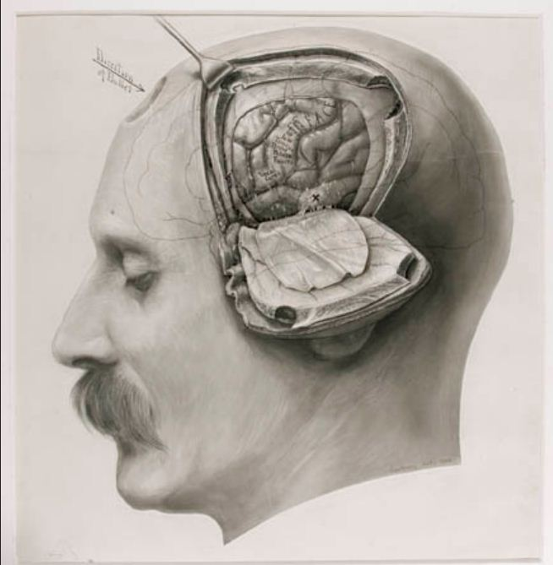
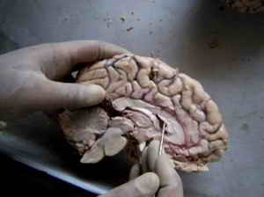
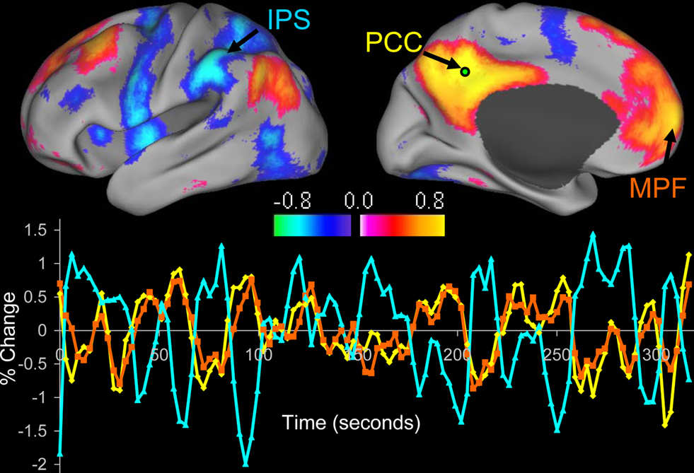
Neuroscience…
Has made huge leaps by using
technology to study and understand how nerves, nervous systems and brains are structured and function.

Slide 3
Disclaimer
The views expressed in this lecture are those of the presenter, and do not necessarily reflect those of the supporting agencies and orgnaizations, the US Department of Defense, US Special Operations Command, and/or the Defense Advanced Research Project Agency (DARPA).

Slide 4
Science, Tools and Techniques (ST&T)
Radical Leveling ST&T: Currently available for novel applications that “level” the basis of engagement
Emerging ST&T: Approaches that are currently under development for use within defined vistas of engagement (e.g.- 1-5 yrs; 6-15 yrs)

Slide 5

Neuroscience and Technology (NeuroS/T)…
Practice, Possibility & Potential...
To harness and engage neuroS/T in convergent, multi-disciplinary approaches to study, define, predict and influence human ecologies
Affect human activities on individual, group and populational levels
To affect human relations on local, regional and global scales
Influence postures and conduct of national security and defense agenda(s)

Slide 6
Neuroscience, Neurotechnology…in NSID
2008 NAS-NRC Report: NeuroS/T not yet viable for operational NISID use
2011-2014 SMA Pentagon Whitepapers: Demonstrated utility of NeuroS/T in prior, current and future NSID operations
2010 PIPS Neurotechnology Futures Report: NeuroS/T valuable and conclusively viable for operational use in NSID
2013 Nuffield Council Report: NeuroS/T historically and currently considered for military operational use
2014 NAS-NRC Report: NeuroS/T valid, valuable and already in operational NSID use

Slide 7
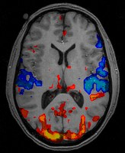

NeuroS/T in NSID
Access-Assess-Affect
Assessment Technologies
  Neuroimaging
  Neurophysiological recording
  Neurogenomics and genetics
  Neuroproteomics
  Neuro-cyber informatics
Interventional Technologies
  Cyber-linked neurocog manipulation
  Directed energy devices
  Novel pharmaceuticals
  Transcranial neuromodulation
  Implantable BMIs
  Neuromicrobiologicals
  Organic neurotoxins
  Nanoneurotechnologicals

Slide 8
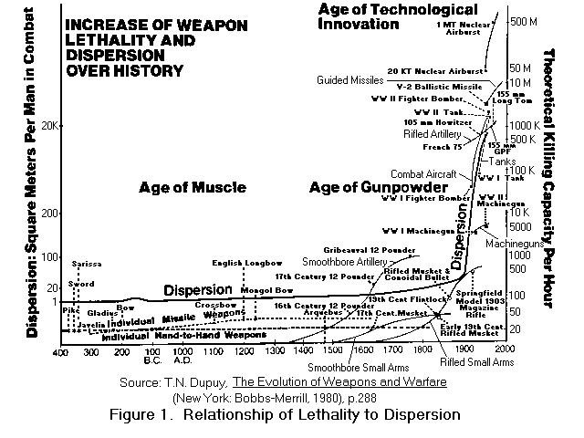
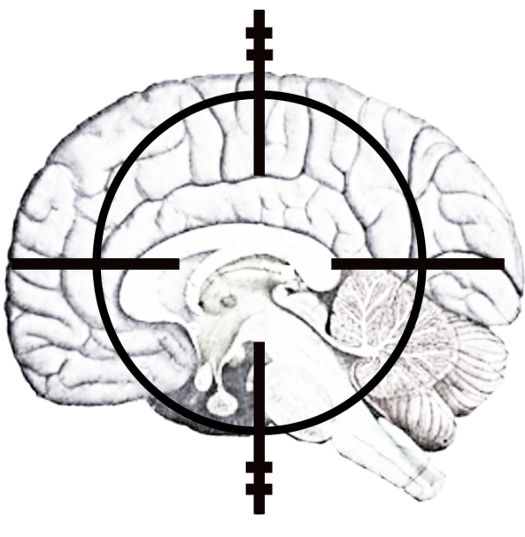
NeuroS/T as Weapons
“Soft”
  Economic leverage(s)
  Intelligence
  PSYOPS/MISO
“Hard”
  Physical influence/deterrence tools
    Chemicals
      Drugs and other chemical agents
    Biologicals
      Microbes
      Toxins
    Devices
      Neurotechnologies
        Assess-Access-Affect
      Hybrid “cyborg” systems (Biological ‘drones’)

Slide 9
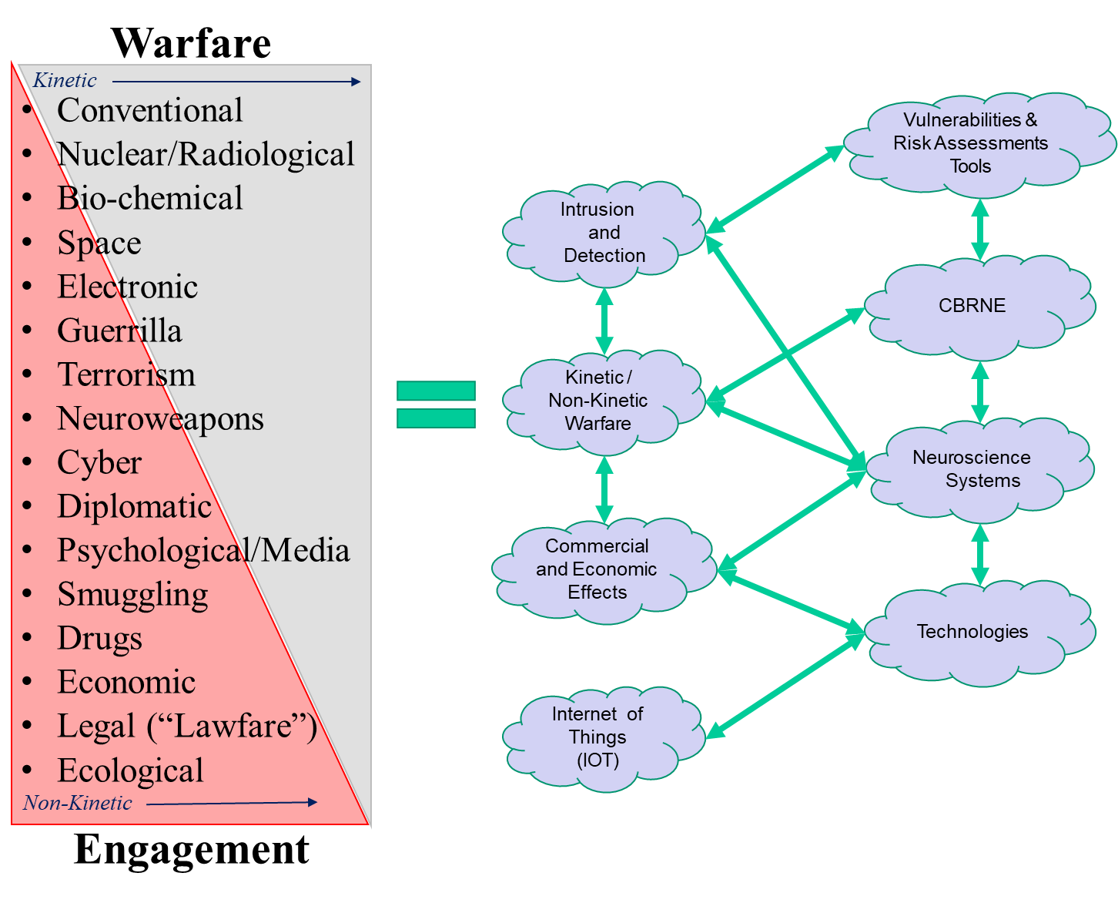
NeuroS/T in Conflict Hierarchy

Slide 10
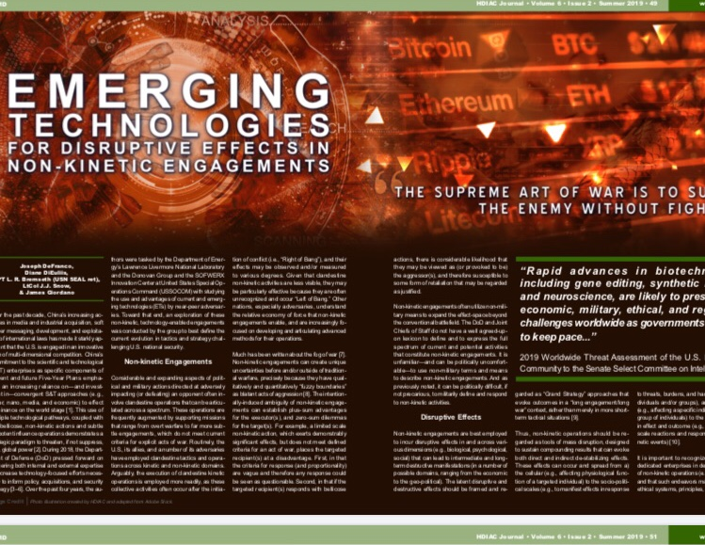

Slide 11
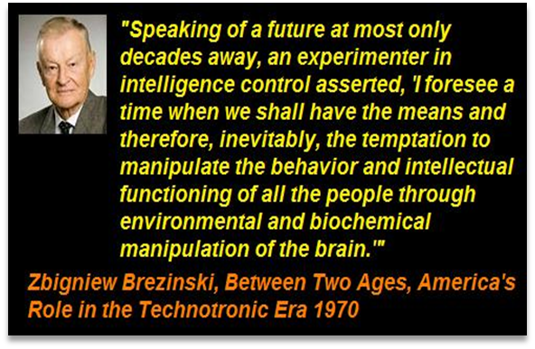
Engaging the Battlespace
1. By fortifying one’s own forces
2. By affecting competing/hostile forces

Slide 12
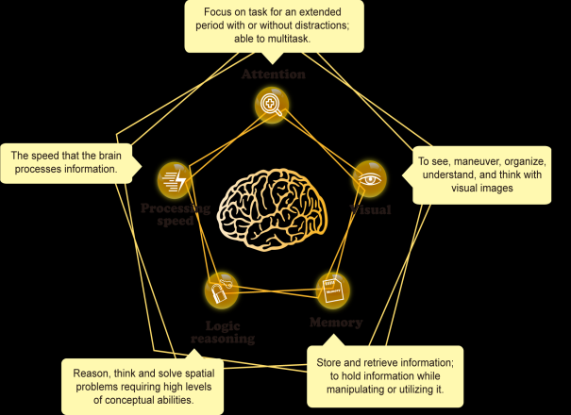
NeuroS/T for Operator HOPE
  Neuro-enablement
    Advanced neuro-psychopharmacologics
    Computational brain-machine interfaces
    Closed-loop brain stimulation approaches
    Neuro-sensory augmentation devices

Slide 13
Beyond BTWC/CWC:
Emerging Threats in NeuroS/T
“Left-of-Bang” Preventive/Occupational Medical Interventions
-Operator optimization for mission protection
-Operator optimization for mission effectiveness
-Modified operator as “biological agent”?

Slide 14
Non-Kinetic Engagements
Novel Neuroweapons (Drugs & Bugs...)
  In-close pharmaceuticals and organic neurotoxins
    Ultra-low dose/high specify agents for use in targeting diplomatic/local culture “hearts and minds” scenarios*
  High morbidity neuro-microbiologic agents
    Neuro-microbials with high neuro-psychiatric symptom clusters for public panic/public health dis-integrative effects
    Gene-edited microbiologcals with novel morbidity/mortality profiles
  Nano-neuroparticulate agents
  High CNS aggregation lead/carbon-silicate nanofibers (network disrupters)*
  Neurovascular hemorrhagic agents (for in-close and population use as “stroke epidemic” induction agents*

Slide 15
Non-Kinetic Engagements, Cont’d
Neuroweapons... (Devices)
  Neurosensory immobilizing agents
    High output sensory stimulators (UAV, drone, insect borne)
  Trans- and intracranial pulse stimulators
    Neural network disrupters (“confusion generators”; Hand held, UAV, drone and insect-borne )
IW
  “Neuro-Ops” Altered Reality Tactics
    Cortically-coupled neural temporal function alteration (“time warpers”)
    Pharmacologic+neurostimulation-induced cognitive-emotional disruption*

Slide 16
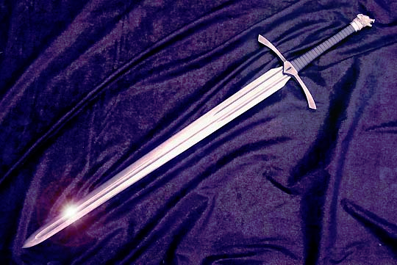
Beyond BTWC/CWC:
Emerging Threats in NeuroS/T
Neuromodulating bioagents
  Peptides
    Opioids
    Enzymes
    Immuno/inflammatory modulators
Modified microbes
  CRISPR-gene-edited agents
    “Precision” pathologies
Nanoneurotechnologies
  Vectorable nanomaterials
  Aerosolizable nanomaterials/nanobots
Neurodata

Slide 17
Challenges...and Opportunities
Relative facility of NeuroS/T
  “Off the shelf”
  Dedicated efforts
    Nations and independent actors
Recognition of viability of use
  Variety of applications
Lack of commitment to NeuroS/T RDT does not preclude others’ RDT initiatives
  May augment it
  Difficulty of global surety

Slide 18
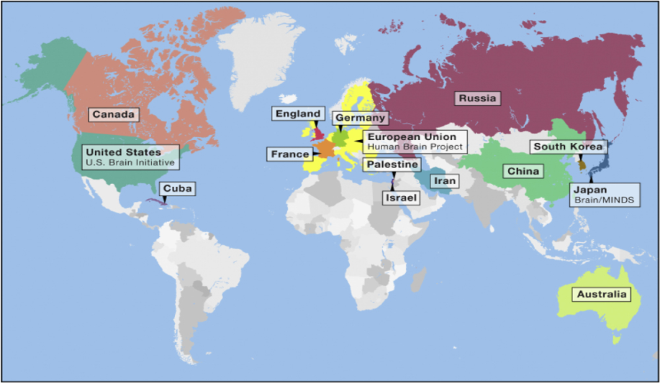
NeuroS/T on World Stage
Global NeuroS/T Economic Predictions 2020
  China (on pace to out-spend U.S. by an order of magnitude over the next 10 years)
    Predicted 60-68% increase in RDTE by 2025
    Predicted 50-53% market share by 2025
  Russia
  Iran
  North Korea
  Virtual nations
  Non-state actors
Lack of focus and commitment by one faction provides exponential growth opportunities for others

Slide 19
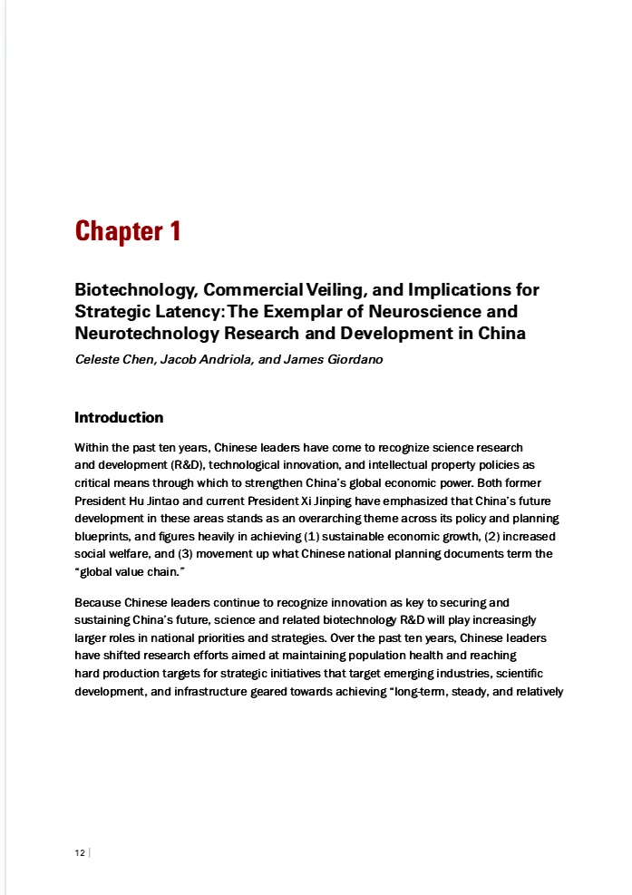

Slide 20

Neuroscience and Technology (NeuroS/T)…
Puts the brain at our fingertips
As Weapon of Mass DISRUPTION...
  RDTE not necessarily bounded by BTWC/CWC
  Highly effective
  Can be clandestine or attributable in use
  Incurs “ripple effects” on/across scales and levels
    See: Giordano J, Nat Def , 2017; Giordano J, ‘Neurotechnology, global relations and national security: Shifting contexts and neuroethical demands’; and: Wurzman R, Giordano, J. ‘NEURINT and neuroweapons’ ; In: Giordano J (ed.) Neurotechnology in National Security and Defense, CRC Press (2015).

Slide 21
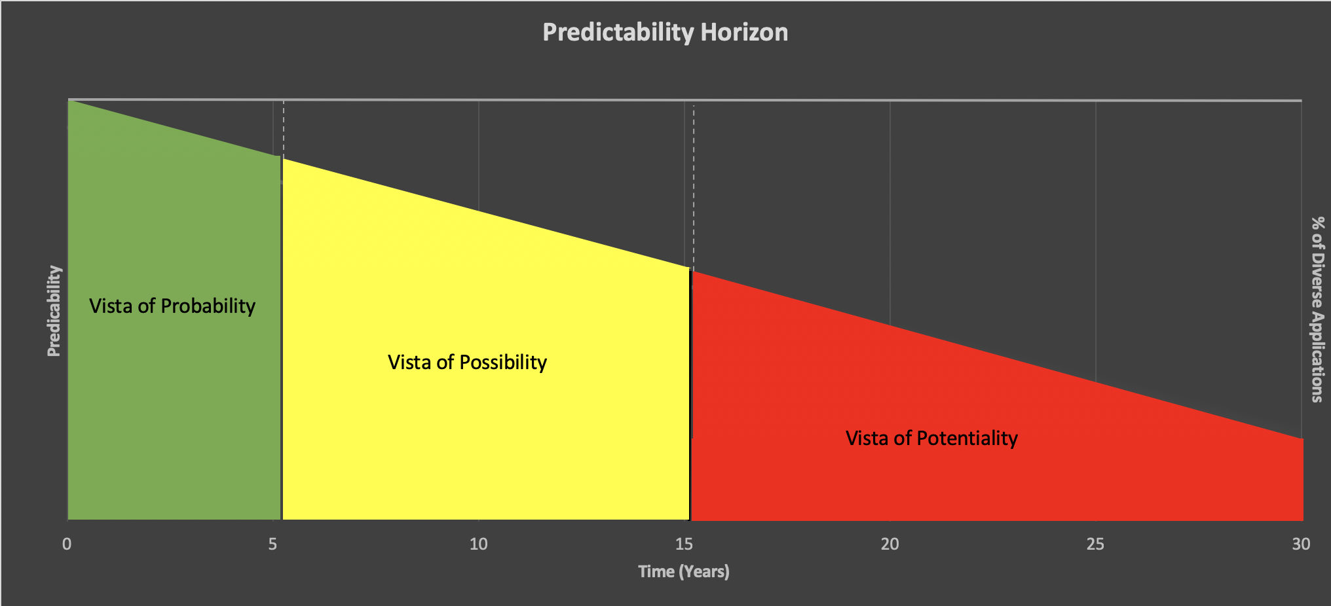
Vistas of S/T Development
Vista of:
Probability: Present to 5 years
  “What exists now, and ‘soon’…”
Possibility: 5 to 10 years
  “Given probabilities, what might occur…”
Potentiality: 10 to 25/30 years
  “Given possibilities, what could be done with them…”

Slide 22
NeuroS/T in NSID
Access and manipulate neural systems/brains to
“…win minds and hearts”.
What we can do is provocative…
What we should do, and:
how we should do so…
…if we can do what we should?
remain at issue.

Slide 23
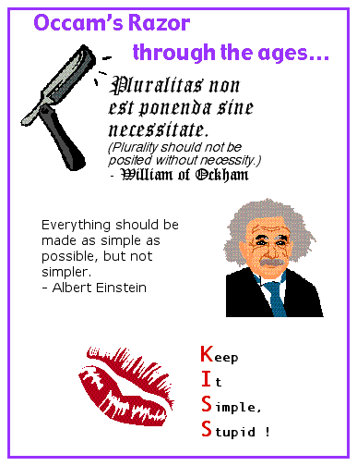
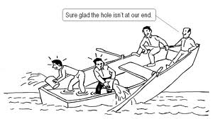
Path Forward
“How do we shave with Ockham’s Razor while in Neurath’s Boat”

Slide 24
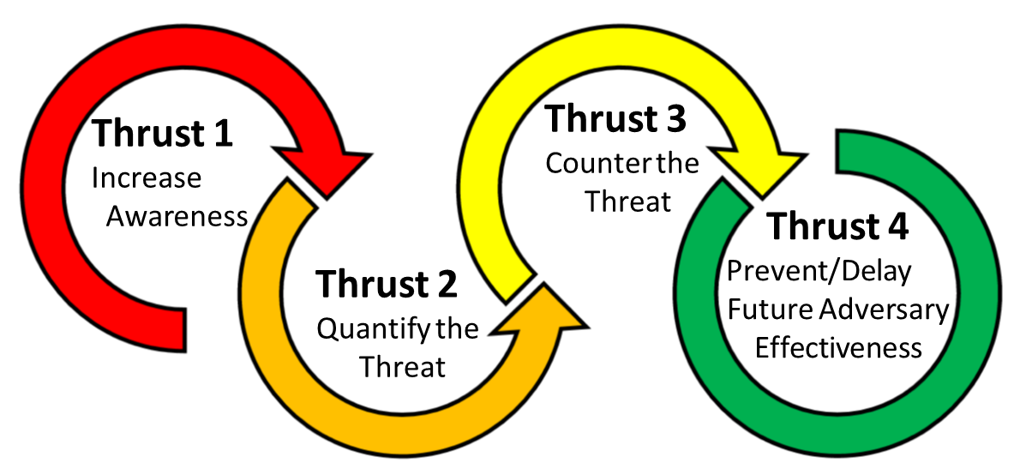
ETT Four Thrust Strategy
Addressing ETT should employ a Whole of Nation approach to identify, characterize, counter, and exploit/prevent emerging technologies that threaten or erode United States' security and stability

Slide 25
Practicality
May require some degree of non-transparency, to avoid
  Exploitation by hostile groups
  Misperception by public
  False expectation/apprehension
“Prudent Parentalism” as NSID Initiative
Strive for “moral high-ground”
HOW?

Slide 26
Ethical Approaches
Prudent Parentalism mandates:
Regulated transparency
Dedicated surveillance of S/T RDTE
Frank public communication of process, relative progress, and importance
Responsible oversight, governance and control
Engagement of multi-disciplinary advisory groups
Appreciation of inter-national/cultural factors

Slide 27

ON-RAMP:Operational Neurotechnology Risk Assessment and Management Paradigm
Evaluate neuroS/T capabilities/limitations
Evaluate parameters of possible use
Frame within contexts of application
Assess benefit-risk-harm parameters

Slide 28

Neuroscience, Neurotechnology and Neuroweapons
With increasing knowledge comes great power…
…With great power comes great responsibility

Slide 29
Additional Information
Giordano J. Battlescape brain: Engaging neuroscience in defense operations. HDIAC Journal 3:4: 13-16 (2017).
Palchik G, Chen C, Giordano J. Monkey business? Development, influence and ethics of potentially dual-use brain science on the world stage. Neuroethics, 10:1-4 (2017).
Giordano J. Toward an operational neuroethical risk analysis and mitigation paradigm for emerging neuroscience and technology (neuroS/T). Exp Neurol 287 (4): 492-495 (2017).
Tennison M, Giordano J, Moreno J. Security threats vs aggregated truths: Ethical issues in the use of neuroscience and neurotechnology for national security. In: Illes J, Hossein J. (eds.) Neuroethics: Defining the Issues in Theory, Practice and Policy. Oxford, Oxford university Press, 2017.
Giordano J, Wurzman R. Integrative computational and neurocognitive science and technology for intelligence operations: Horizons of potential viability, value and opportunity. STEPS- Sci, Technol, Engineer, Policy Studies, 2(1): 34-38 (2016).
Giordano J. The neuroweapons threat. Bull Atomic Sci 72(3): 1-4 (2016).
Giordano J, Kulkarni A, Farwell J. Deliver us from evil? The temptation, realities and neuroethico-legal issues of employing assessment neurotechnologies in public safety. Theoret Med Bioethics 15(3); (2014).
Giordano J, Wurzman R. Neurotechnology as weapons in national intelligence and defense. Synesis: A Journal of Science, Technology, Ethics and Policy 2: 138-151 (2011).
Giordano J, Forsythe C, Olds J. Neuroscience, neurotechnology and national security: The need for preparedness and an ethics of responsible action. AJOB-Neuroscience 1(2): 1-3 (2010).

Slide 30
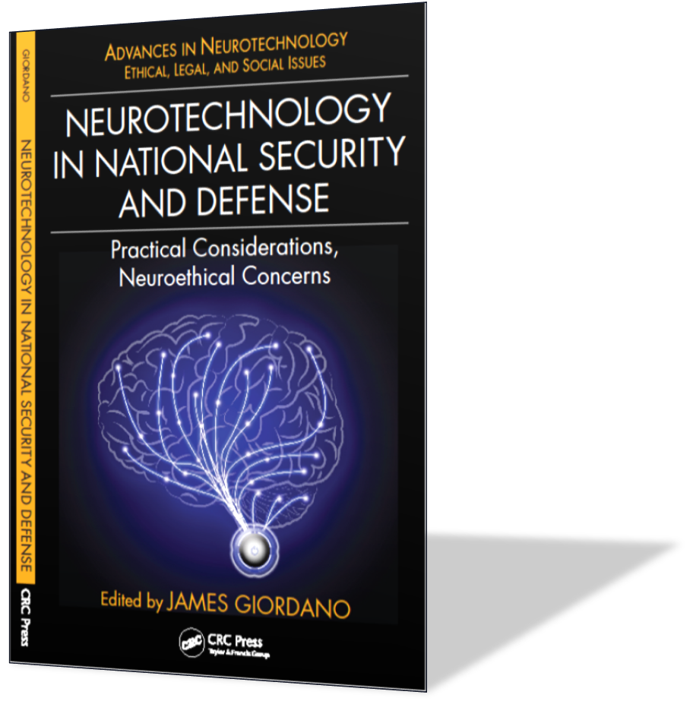
Read More...

Slide 31
Acknowledgements
Supported in part by funding from CSCI; Leadership Initiatives, a grant form the Air Force Office of Scientific Research and federal funds UL1TR001409 from the National Center for Advancing Translational Sciences (NCATS), National Institutes of Health, through the Clinical and Translational Science Awards Program (CTSA), a trademark of the Department of Health and Human Services, part of the Roadmap Initiative, “Re-Engineering the Clinical Research Enterprise”.

Slide 32

Contact
Prof. James Giordano PhD
James.Giordano@georgetown.edu

