Slide 1



THE
INCOME SUPPORT
AND
SOCIAL INCLUSION system
FUNDAMENTAL FOR SOCIAL COHESION
IN THE BASQUE COUNTRY
Gotzone SAGARDUI
Labour Activation Director
Juan IBARRETXE
Education for employment and Basic Income Director
Brussels, 6th april 2016

Slide 2
Background to the introduction of the Income Support Benefit

Slide 3
Background
25 years ago INDUSTRIAL CRISIS
  Basque unemployment rates
  1973 unemployment rate nearly zero
  1984 unemployment rate 22.5 %
  Basque GDP
      1975-1985 negative growth -0.3 % (+1.7 % Spain)
  Per capita income
      Only autonomous community where it fell between 1973 and 1981
      Bizkaia: from 2nd position in the State ranking to 21st in 1985
Notes:
In 1987, a Basque Government’s Ministry of Labour, Health and Social Security report, ‘Poverty in the Basque Autonomous Community’, pinpointed the existence of significant pockets of precariousness and of serious poverty in the Basque Country. They were the direct consequence of the industrial restructuring processes at the end of the 1970s and early 1980s. That crisis caused the unemployment rate in the Basque Country to rise to over 20%.
The Basque Country was at the time noted for an obvious loss of economic strength. Between 1975 and 1985, GDP growth was negative (-0.3%), far below the positive 1.75% recorded for Spain as a whole. The Basque Country was also the only Autonomous Community of the State of Spain, whose per capita income fell between 1973 and 1981. Between 1981 and 1985, this indicator stagnated at a growth rate of 0.1% compared to 0.7% for Spain.
The decline of the Basque Country was first and foremost most clearly noted in the indicators most directly related to the welfare of the families, such as the disposable household income per capita. After being among the top places in the mid-1970s, the Basque provinces then fell down the rankings of household income in Spain. Bizkaia, led by Bilbao, suffered the most striking fall, as it dropped from second place in the early 1970s to number 21 in 1985.

Slide 4
Background
    Structural unemployment horizon
    "New Poor"
    Collapse of the social cohesion
    Prospect of social exclusion
Notes:
The discussion of the Government study was quickly taken up by the Basque Parliament. Thus, the Basque Parliament Plenary session passed, on 8 May 1987, a motion regarding the poverty affecting numerous Basque families, as follows:
“The Basque Parliament urges the Basque Government to implement a specific programme regarding the poverty existing in the Autonomous Community. To that end, the Parliamentary Committee in question shall prepared a bill, taking into account the data contained in the progress report that the Basque Government has recently published on poverty in the Autonomous Community”.
The acceptance of this challenge by the Basque Government marked the start of the process that would lead to the Comprehensive Poverty Eradication Plan being implemented in early 1989. In 1990, the Basque Parliament passed the first minimum income regional legislation in Spain, the Job-Seekers Allowance (IMI) Act 2/1990, of 3 May, thus consolidating the Minimum Household Income introduced in February 1989.

Slide 5
Background
Basque Government.:
1987 Study on Disadvantaged Social Situations
Poverty in the Basque Autonomous Community (Avance)
1989 Integral Plan to Combat Poverty
The objective focused
on consolidating the most wide-spread welfare possible.
    1989 MINIMUM FAMILY INCOME
    1990 JOB SEEKER'S ALLOWANCE
    2008 INCOME SUPPORT BENEFIT
Notes:
In an article published on 7 March 1989, the Basque Government’s then Minister for Labour and Social Security, José Ignacio Arrieta, noted the three basic principles behind the introduction of the first Minimum Household Income.
Three basic principles have inspired the stalwarts of the minimum household income at the time of its regulation. The first, that it was not a substitute programme of the different social programmes that currently exist in our Autonomous Community. Second, that it is not, or seeks to be, about creating a new welfare dependant class by creating chronic situations of marginalisation; and third – and, in my opinion, the most fundamental given the challenge involved -, that we must be capable with this benefit to create a situation that helps the beneficiaries to be able to leave the programme and the underlying causes and, consequently, to escape the situation in which they find themselves.;

Slide 6
Context
Basque Government.:
1989 BASIC INCOME
"In the Basque Country, we have embraced marginalization not as a problem that it suffers from but rather as one of society, and as such, its solution cannot be the property of anyone, but rather the responsibility of everyone".
Jose Ignacio Arrieta Heras
7 MARCH 1989
Notes:
The Minimum Household Income marked the start of a path which would subsequently become a trail-blazer through the different reform measures, in general, inspired by advances in improving how situations of need were addressed. This journey would end with the current public benefit system to guarantee income, based on the Income Support (RGI), with its employment bonus system, the Housing Benefit (PCV) and Social Emergency Assistance (AES).

Slide 7
Principles underlying the Basque Income Support model

Slide 8
Principles underlying the Basque model
1.CONSOLIDATING THE RIGHT TO A LIVELIHOOD
Subjective right
2. PREVENTING THE SLIDE INTO CHRONIC POVERTY
Right to the income support benefit for people on low incomes.
Being able to have certain assets, while receiving the benefit.
AES (Social Emergency Assistance) aimed at access to basic facilities and overcoming shortcomings in housing amenities.

Slide 9
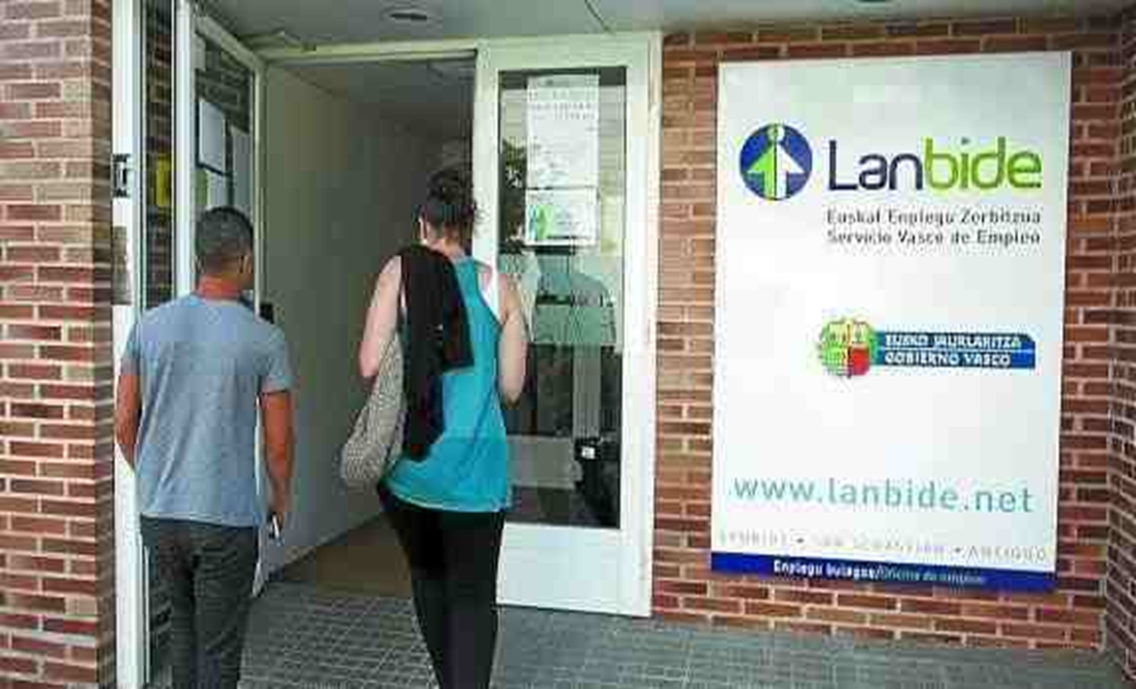
Underlying principles
3. SYSTEM DRIVING EMPLOYMENT
Work incentive policy to ensure that the people on income support have a higher income level if they are working.

Slide 10

Underlying principles
4. AGREED APPROACHES
Dual right to guaranteed resources and to job finding/inclusion.
No blame job finding/inclusion processes.
Support for additional job finding formulas (Auzolan, job finding companies).
Objecting to compulsory forms of work tradeoffs.

Slide 11
Main characteristics of
Income support (RGI)/housing benefit (PCV)

Slide 12
Access conditions
3-year minimum period on the ELECTORAL ROLL.
  Or I have been on the electoral roll for 1 year and also have proof of 5 years' paid employment.
  Or I have been on the electoral roll for 5 consecutive years in the last 10.
AGE minimum of 23 years old.
  People over 18 years old can collect it in certain cases
You have applied for ALL the other AID to which you are entitled.
You do not own any other PROPERTY, except for your usual place of residence including the storeoom and garage.

Slide 13
Achievements

Slide 14
Achievements
An innovative benefit system right from the start
A system established over 25 years.
Work incentives as a means to leave poverty.
A transparent, uniform and simple benefit.
One-stop-shop transfer of the management to the Basque Government.
Inclusion Convention single model for the 3 provincial councils.
With positive economic and social results.

Slide 15
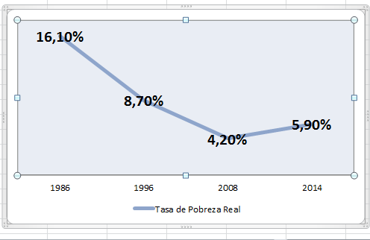
REAL POVERTY TASA
Notes:
The results of the Basque income guarantee system, designed to offset the shortfalls and limitations of the Spanish general welfare system, should be analysed.
From a strictly social perspective, it is true that the Basque income guarantee system has not completely withstood the onslaughts of the latest crisis. The real poverty rate has increased from 4.2% in 2008, when it reached its lowest point, to 5.9% in 2014. Yet it continues to be far behind the 8.7% in 1996, during the last crisis comparable to the current one, when two far-reaching demographic phenomena had still not occurred: foreign immigration and the large-scale emancipation of the young population affected by the crisis of the 1980s and the early 1990s. In any event, the current real poverty rate is far behind the 16.1% that existed in 1986, prior to the first income guarantee programme in the Basque Country.

Slide 16
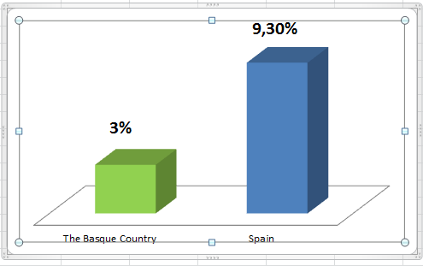
SERIOUS POVERTY
Notes:
In the State context, the Basque Country stands out for its better record in controlling poverty situations. Taking the serious poverty threshold in Spain (<40% of the average income) as the benchmark, the Basque Country posts a rate of 3%, under a third of the 9.3% for Spain as a whole.

Slide 17
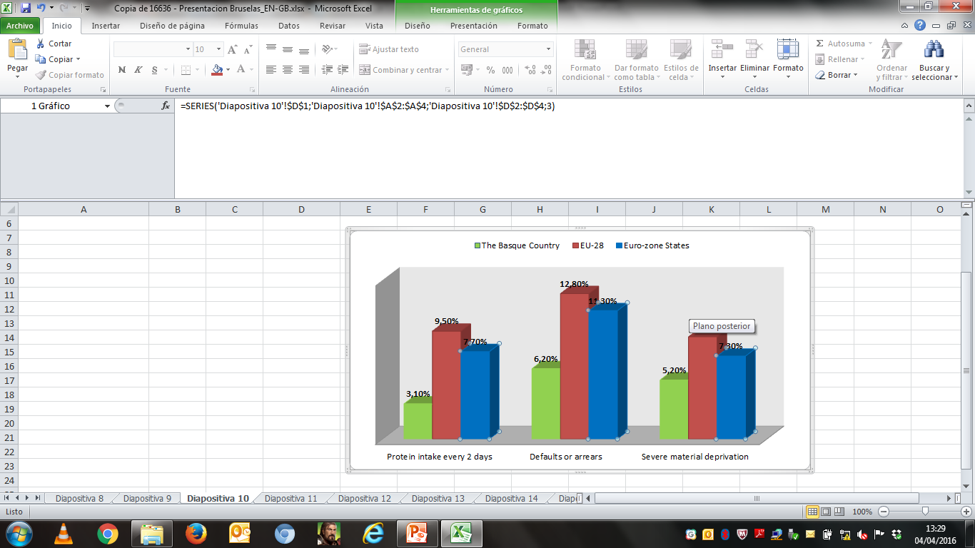
PROTEIN INTAKE
Notes:
Despite the crisis and an unemployment rate higher than that of the socially most advanced countries of Europe, the Basque Country was close to those countries in 2014 in terms of the indicators most closely linked to the experience of severe poverty, such as the impact of nutrition problems or the effects of defaults and arrears. As regards those indicators, the Basque figures are clearly ahead of European averages: 3.1% not eating protein every two days in the Basque Country compared to 9.5% in the EU-28 and 7.7% in the euro-zone states; 6.2% with defaults or arrears compared to 12.8% in the EU-28 and 11.3% in the euro-zone States. The comparatively favourable position can also be observed regarding the impact of severe material deprivation: 5.2% in the Basque Country compared to 9% in the EU-28 and 7.3% in the euro zone.

Slide 18
Achievements
In 2014, the income guarantee system reached 72.9% of the population at risk of poverty.
Access to the RGI manages to overcome real poverty in the case of 80,499 personas, 3.7 % of the population of the BAC and 38.7 % of the population at risk (2014).
Jobs safeguarded: 4,567 direct (via consumption) and 22,203 jobs indirectly (work incentives).
The Basque GDP would shrink by around 2 % in the case of nearing the lack of welfare rates recorded in Madrid and Catalonia.

Slide 19
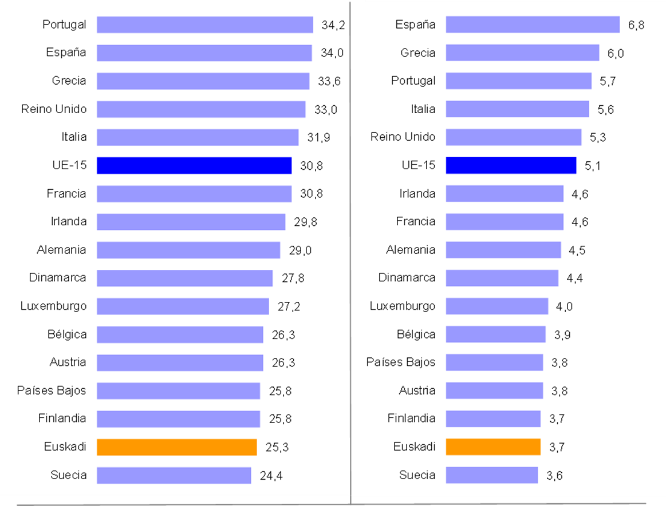
SOCIAL COHESION
Notes:
It should also be pointed out that the income guarantee policy in the Basque Country was not only designed to guarantee access to minimum resources in the short term. The technical design of its programmes was in such a way so as to guarantee the economic stability of the population in the long term. And that is where it has been most successful.

Slide 20
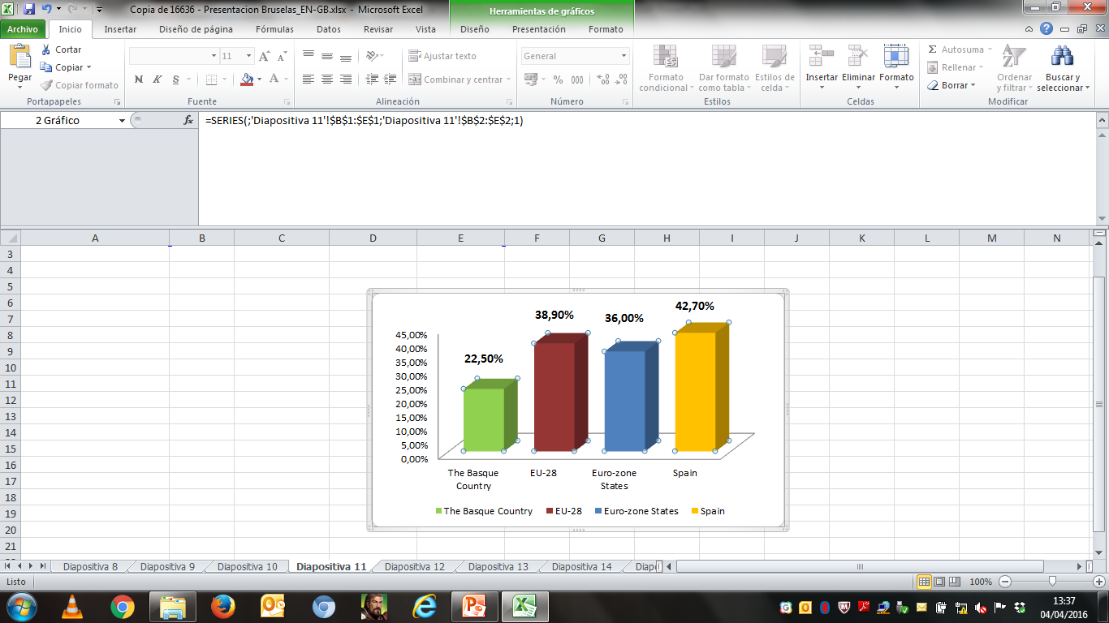
SOCIAL COHESION
Notes:
Some figures clearly endorse that statement. Thus, for example, the proportion of people in households without resources to cover extra expenses stands at 22.5% in the Basque Country. The indicator is 42.7% in Spain, 38.9% in the EU-28 and 36% in the euro zone. Germany and France are at around 33%. Only Sweden, in the European Union, is lower than the BAC in this indicator.
This situation is the basis of the financial stability of Basque families and of their low risk of overindebtedness (1.7% in 2014). It also explains the limited impact of evictions in the Basque Country and how the Basque financial system has well withstood the crisis.

Slide 21
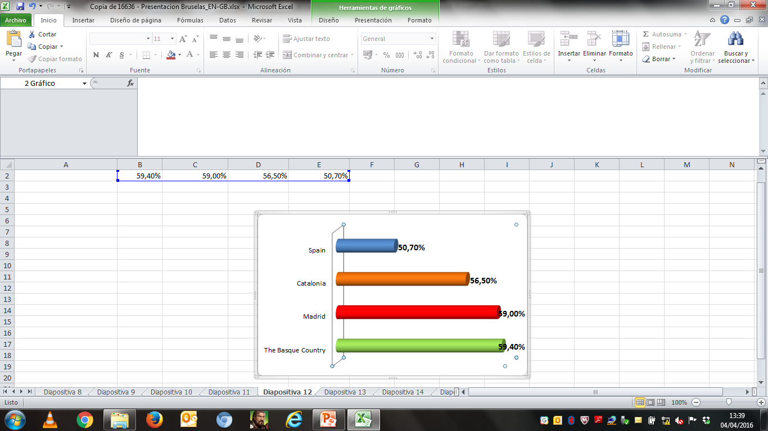
HUMAN DEVELOPMENT
Notes:
The contribution of the Basque income guarantee system to social stability has also had economic impacts. As regards employment, the Basque Country is the Autonomous Community that had the highest proportion of people registered with the Social Security System in the working age population overall at the peak of the crisis: 59.4% at the end of 2013 compared to 59% in Madrid, 56.5% in Catalonia and an average of 50.7% in Spain.

Slide 22
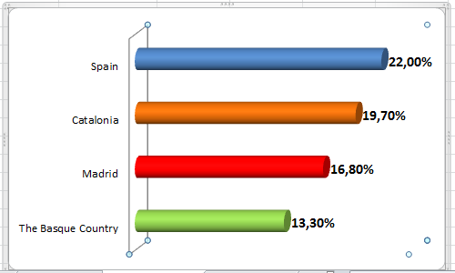
HUMAN DEVELOPMENT
Notes:
The economic automatic stabilisation processes associated to the income guarantee policy explain why the Basque Country has also been the Community less affected by unemployment in Spain, with an average of 13.3% between 2009 and 2013, compared to 16.8% in Madrid, 19.7% in Catalonia and 22% in Spain.

Slide 23
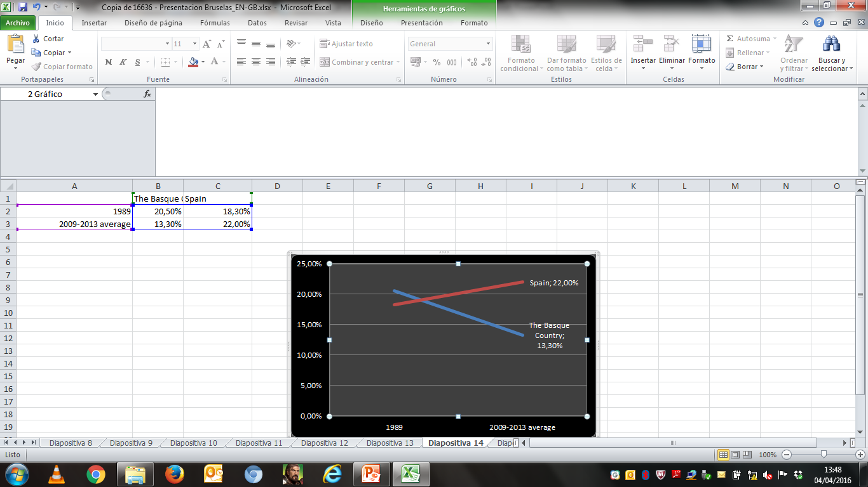
UNEMPLOYMENT
Notes:
That 13.3% average unemployment is over 7 points under the 20.5% rate in the Basque Country when the first income guarantee programme was introduced in 1989. On the other hand, the 22% average unemployment during the period 2009-2013 in Spain is higher than the 18.3% in 1989. And the Basque Country now stands out as being one of the communities with the lowest unemployment in Spain. In 1989 in contrast, prior to the income guarantee programme being launched, its unemployment rate was only lower to that of the poorest areas of Spain (Canary Islands, Andalusia and Extremadura). The industrial restructuring had left the Basque Country in a crisis situation and a time of great uncertainty.

Slide 24
Conclusion:
Two positive aspects of the Income Support and Social Inclusion System in the Basque Country
The system in place is not perfect and has limitations, but the outcome has two clear positive aspects:
a) The foundations have been laid for a welfare model, whose fundamental features have been upheld for 25 years in the Basque Country and which has contributed to the differential improvement of the economic and social position of the Basque Country in the European and State context.
b) A basis of spending on income support policies has been positively integrated in the social model. This facilitates any scheme to reform, progress or improve that Basque society may consider in the future.

Slide 25
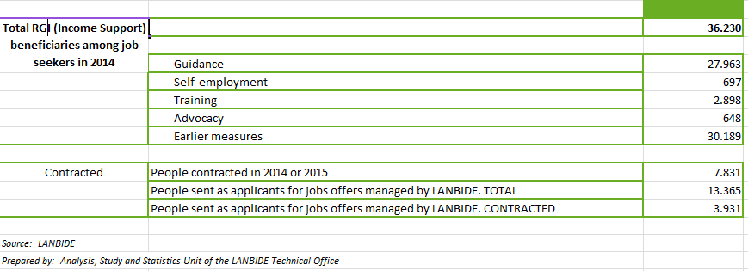
Main characteristics
5. RGI beneficiaries SEARCH ACTIVELY for work:

Slide 26
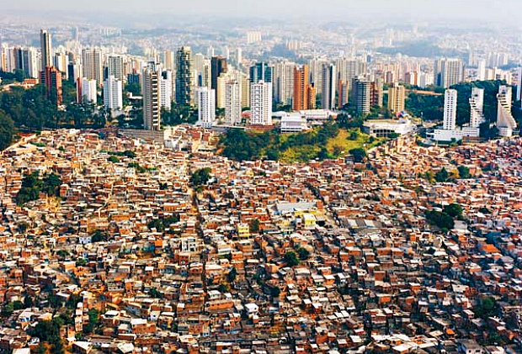
REFLEXION
WE FIRLY BET FOR ECONOMIC SYSTEMS AT THE SERVICE OF THE HUMAN BEINGS, THOSE ARE THE ONES THAT ERADICATE PROVERTY
Notes:
Our benefit system has obviously helped the inhabitants of the Basque Country to have a better future than the one that they could have expected without such a measure. It is the social legacy of those people that took up the challenge of driving this new social spending policy in the Basque Country at the end of the 1980s.

