Slide 1
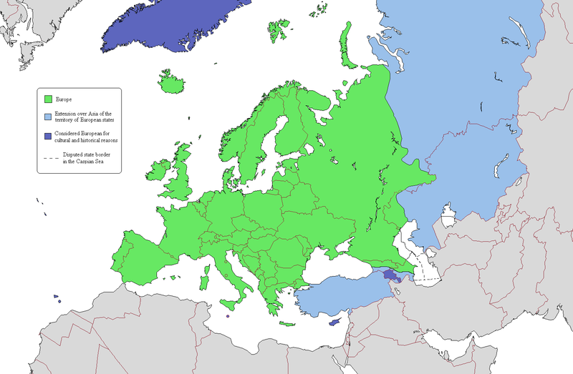
Millennium Project Work&Tech 2050 study with the Basque Government
Ibon Zugasti

Slide 2
Millennium Project Work&Tech 2050 study with the Basque Government
Which is the focus of the BC on the future of work/technology?
The comparison between the results from Basque Country and the global study was conditioned by different future horizons (2030 and 2050), but also by different starting hypotheses that did not initially agree on negative evolution of the job market.
In the BC there was a considerable deviation in answers relating to the importance of the different factors being contemplated
The process in the BC was approached through in-depth interviews using a structured questionnaire that can be assimilated (although not identical) to the global questionnaire

Slide 3
Millennium Project Work&Tech 2050 study with the Basque Government
Worldwide unemployment rates (MP)
Basque unemployment rates (BC)

Slide 4
Millennium Project Work&Tech 2050 study with the Basque Government
TECHNOLOGIES likely to replace rather than create more jobs | Global | BC
Robotics | 1st | 2nd
Integration and synergies among these making technologies not known today | 2nd | 1st
Artificial Intelligence | 3rd | 10th
Artificial general intelligence (Artificial general intelligence attempts to perform the full range of human cognitive abilities whereas AI does not) | 4th | -
Retraining unable to keep up with accelerating technological changes | 5th | -
3D/4D printing | 6th | 4th
Other factors (driverless cars/mobile - cloud/E-Commerce) | 7th | 3rd/5th/6th
Drones | 8th | 7th
Nanotechnology | 9th | 8th
Synthetic biology | 10th | 9th
Augmented reality | - | 11th

Slide 5
Millennium Project Work&Tech 2050 study with the Basque Government
OCCUPATIONS that will be most affected by automation | Basque Country
Operators of facilities and machines and assemblers | 1st
Basic occupations | 2nd
Administrative support staff | 3rd
Officials, operators and craftsmen in mechanics and other professions | 4th
Service workers and business and market salesmen | 5th
Farmers and qualified agro-fishery, forestry and fishery workers | 6th
Technicians and mid-level professionals | 7th
Scientific and intellectual professionals | 8th

Slide 6
Millennium Project Work&Tech 2050 study with the Basque Government
FACTORS creating more jobs than they replace | Global | BC
Growth in new jobs in leisure, recreation, and health care industries | 3 | 1
Human creativity will accelerate across the world | 5 | 2
New economic and work concepts | 1 | 3
Self-employment, freelancing, Do It Yourself support systems, incentives, and training | 2 | 4
Crowd sourcing for finance (Kickstarter) and crowd-sourced work | 7 | 5
Freedom to create new work to make life worthwhile beyond ‘necessary’ work | 4 | 6
Human-technology symbiosis and/or augmentation | 6 | 7
Biological revolution (synthetic biology and other new biology-related industries) | 8 | 8
Self-correcting: as unemployment goes up, purchasing goes down, reducing growth of AI robotic systems, in turn replacing fewer jobs | 9 | 9

Slide 7
Millennium Project Work&Tech 2050 study with the Basque Government
Effectiveness of some suggested ACTIONS to create new work/income | Global | BC
Retraining programs for more advanced skills | 1 | 4
Require science, technology, engineering, mathematics, and coding in all levels of education | 2 | 6
Make increasing national and individual intelligence a national priority | 3 | 1
Create incentives to attract and create advanced skilled jobs | 4 | 5
National innovation programs | 5 | 3
Consolidate public welfare systems into a basic guaranteed income pending national situations | 6 | 13
Create ‘Do It Yourself Maker’ areas, hubs, centres, districts | 7 | 10
Double national R&D budgets by 2020 (to have impact by 2050) | 8 | 2
Create incentives for employee ownership plans | 9 | 9
Make university education free to students | 10 | 8
Tax the new wealth generated by new technology for public financial support | 11 | 11
Massive public training in self-employment | 12 | 7
Government investments in future technology firms with profits from government shares redistributed to unemployed | 13 | 12

Slide 8
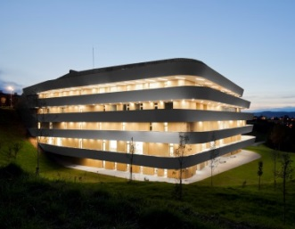
Millennium Project Work&Tech 2050 study with the Basque Government
Which are the main challenges that BC is facing for futures work/technology to 2050?
New ways of understanding work or new industries and relations that might positively affect the future job market
There will be skills that are no longer required or valued by the job market. Certain functions and tasks will be replaced, leading to a transformation of their current functions
The job market will be more uncertain, but there is not complete agreement on the fact that technological development is going to destroy so many jobs.

Slide 9
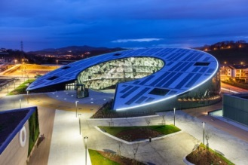
Millennium Project Work&Tech 2050 study with the Basque Government
Which strategies would you propose to address these challenges?
Systemic solutions capable of addressing the several variables involved (training, social policies, economic strategies).
Particular weighting to social, educational and entrepreneurial culture policies that move us away from the most pessimistic scenario.
The ageing of the EU workforce implies that the number of workers leaving jobs that need to be replaced will increase greatly, giving opportunities for the low-skilled workers and those outside the labour market. Particularly if supported by the VET system and more directly by those retiring workers passing on their skills and experience.

Slide 10
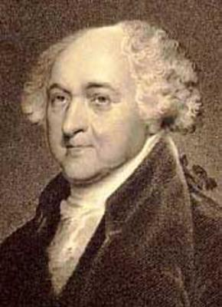
The Basque Country: an age-old people…
“This extraordinary people have preserved their ancient language, genius, laws, government and manners, longer than any other nation of Europe”
John Adams (1786)
President of the United States of America

Slide 11
Eskerrik asko / Gracias!

