Slide 1
The evolution of Collapse
and other futures
THE PUBLIC SECTOR FORESIGHT NETWORK Meeting
July 31, 2019
Jim Dator
Hawaii Research Center for Futures Studies
Department of Political Science
University of Hawaii at Manoa
dator@hawaii.edu

Slide 2
I have been asked to say something about
the evolution of scenarios of Collapse
as I have used them over the years.

Slide 3
In order to do that,
I need to place them into the context
of what are now often called
the Four Generic Images of the Futures
of the Manoa School.

Slide 4
The Collapse image of the futures only makes sense
in relation to the other three,
and all four have co-evolved in content
and to some extent in basic form
since I first decided on the typology in the early 1970s.

Slide 5
Like many people then,
I entered the futures field in the late 1960s
with a very positivistic, high-tech, space-age
image of the future,
.

Slide 6
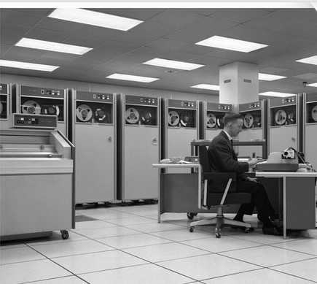
and with the certainty that
I could develop computer models
that would enable me
to “predict” THE future.

Slide 7
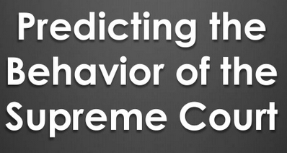
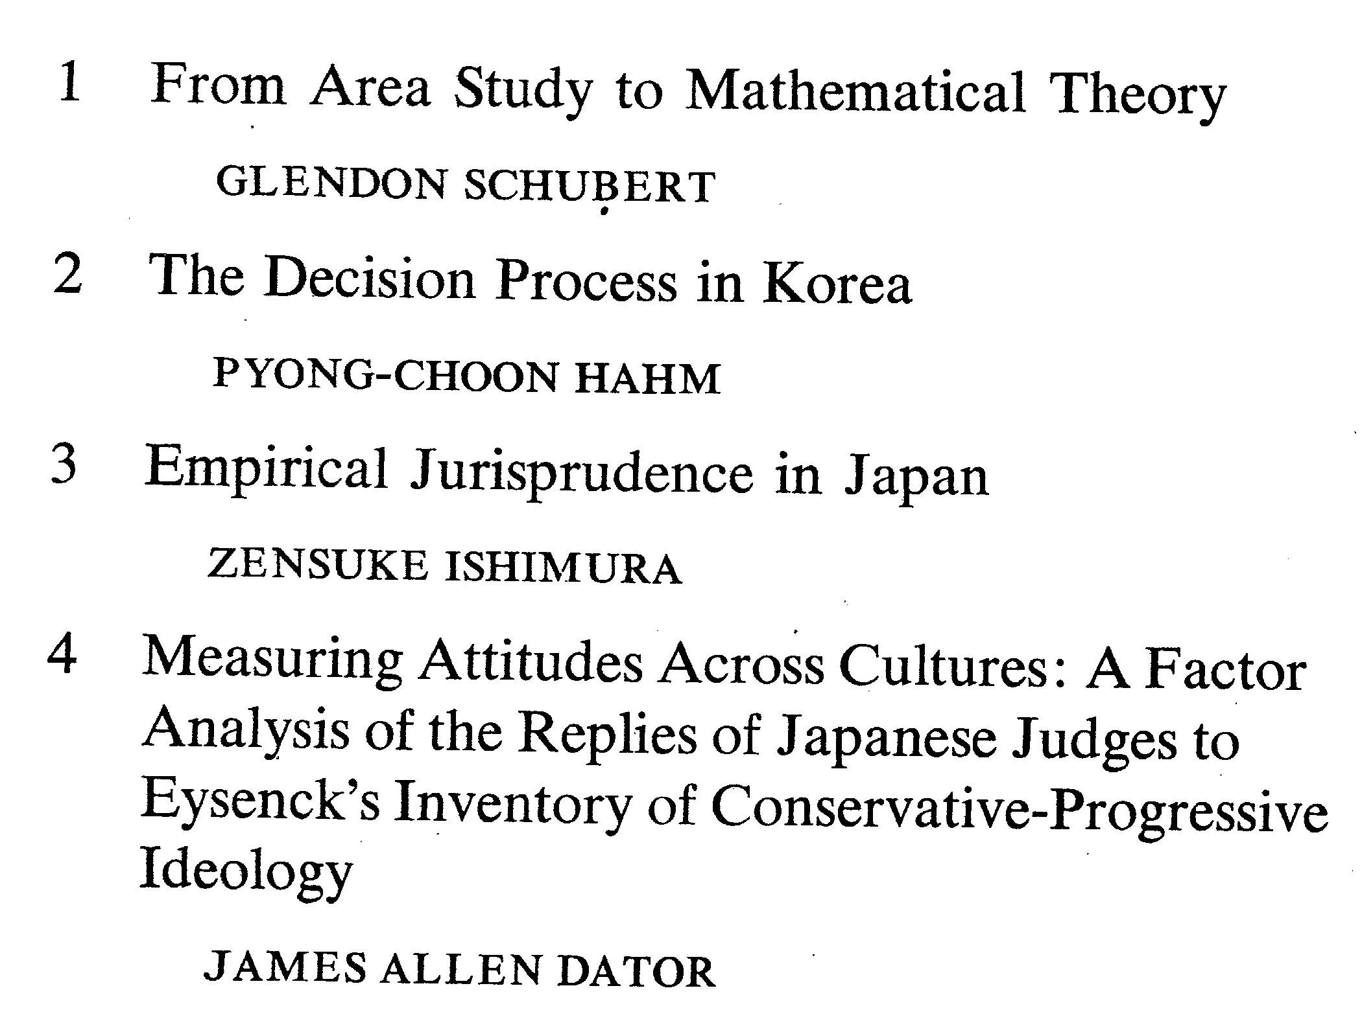
After all, I was a young political scientist,
trained during the “behavioral revolution”,
specializing in predicting things like elections,
legislative role call votes, and in my case,
judicial decisions.

Slide 8
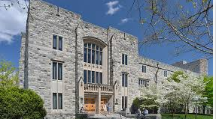
However, one thing I have always loved doing
is creating bibliographies,
and so I immediately began reading everything I could find
about “the future”.
I amassed a long list of books and articles
for the futures classes
that I began teaching at Virginia Tech in 1967.

Slide 9
As I read deeper and deeper in the literature,
I discovered that
there were many more images of the future out there
than I had imagined.
And I began noticing that while
the future appeared bright and hopeful to some people,
it seemed dark and foreboding for others.

Slide 10
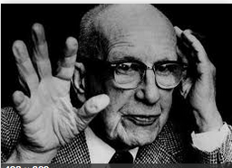
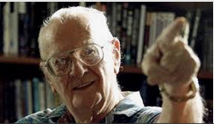
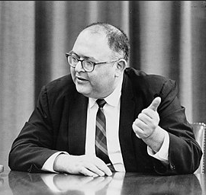
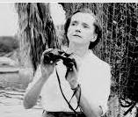
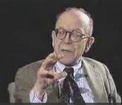
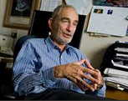
For every
Buckminster Fuller, Arthur C Clarke, and Herman Kahn,
there was a Rachel Carson, Paul Ehrlich,
and Robert Heilbroner,

Slide 11
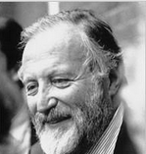
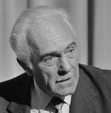
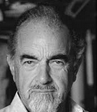
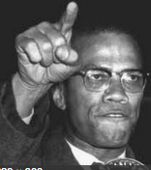
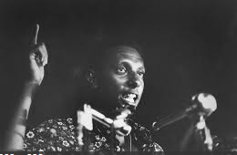
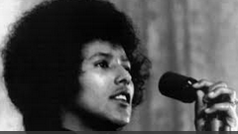
as well as
an Edward Goldsmith, Aurelio Peccei,
and Roberto Vacca.
And there was also
a Malcolm X, Stokely Carmichael,
and Elaine Brown,

Slide 12
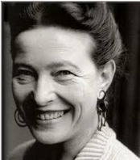
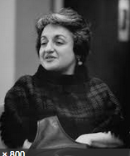
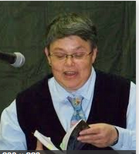
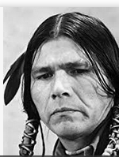
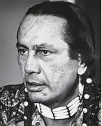
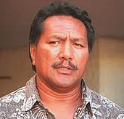
as well as
a Simone de Beauvoir, Betty Friedan,
and Elana Dykewomon,
along with Dennis Banks, Russell Means, Bumpy Kanahele,
and and …well many, many more.

Slide 13
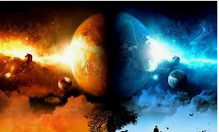
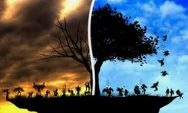
Each group saw “The Future” differently from the others.
What seemed to be a heavenly future to one
was a futuristic hell to another.
What one thought likely,
others though utter fantasy.

Slide 14
Technocratic optimism clashed
with environmental pessimism;
cultural separatists fled from culture-less assimilationists,
One Worlders challenged American Firsters,
and on and on.

Slide 15
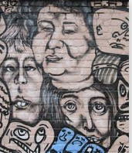
I quickly learned that
there are millions of differing views of what the future
will be, should be, should not be, could be….

Slide 16
As I read more and more of them,
each one of these images eventually made
complete sense to me
from within the logic
of their own values and perspectives.

Slide 17
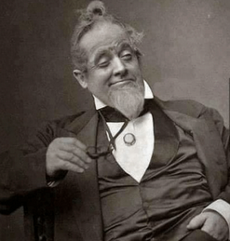
While some appealed to me more than others,
and some appealed to me not at all,
how could I, as a social scientist
(and bleeding heart liberal),
say that my views of the futures would prevail
as the “real” future?
Even less how could I say that my preferred futures
should prevail over theirs?

Slide 18
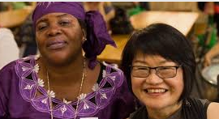
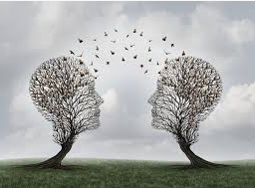
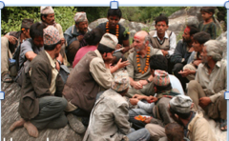
It was my duty
as an academic and consulting futurist
to help people engage with many different
images of the futures;

Slide 19
to test their own “naïve” image
in the light of many other images—
not necessarily to change their minds,
but rather to help their image of and actions
towards the future to be
as robust as possible
whatever “the future” turns out to be;

Slide 20
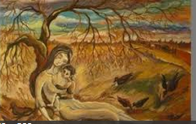
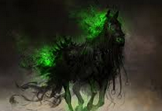
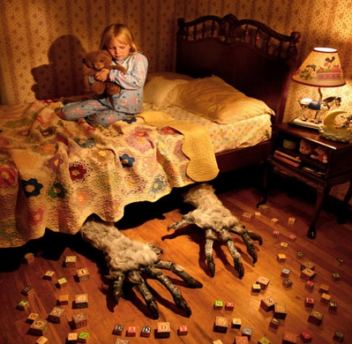
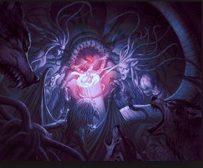
to experience the aspirations and fears of others,
and to consider them in the light of
one’s own aspirational futures and nightmares.

Slide 21
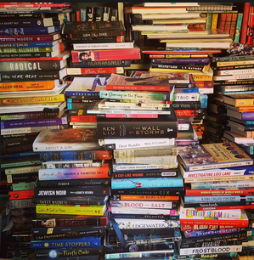
So over a period of a few weeks in 1975,
I literally collected as many images of the future
that I could find.
I read over them, and contemplated
how I might reduce the vast array
to the smallest number of distinct types.

Slide 22
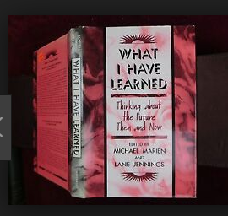
Others in the field were doing something similar at the time.
Michael Marien produced a list of different typologies
then in vogue
(as well as contesting names for the field),
but none seemed right to me.

Slide 23
Eventually I discovered
that I had four piles of images in front of me.

Slide 24
One was very, very tall (in fact several stacks together).
Another was much smaller, but growing in number.
A third was also smaller than the first,
but somewhat taller than the second.
And the fourth was not very tall at all,
but contained images that most people would have called “futuristic” in contrast with the other three.

Slide 25
I initially labeled them
Continued Growth
Collapse
Conserver Society
Transformational Society.

Slide 26
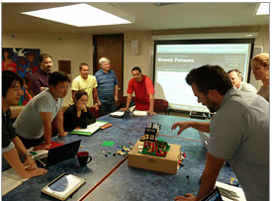
Over the years,
I asked my graduate students
and others
to test that typology
by looking for images of the future that differed entirely
from these four.

Slide 27
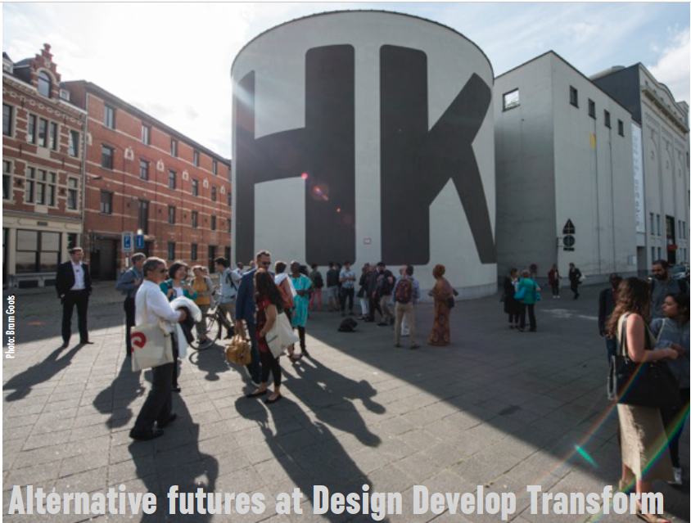
So far, I believe it has stood the test of time,
and currently is enjoying a little boomlet
as more and more people hear of and use
(sometimes misuse)
the typology.

Slide 28
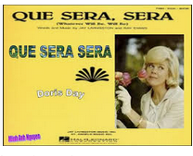
Of course, two, even more generic images, are absent:
One could be called Que Sera, Sera
—the view that the future is flat;
that there are no important differences
between past, present and future,

Slide 29
and anyway,
it is futile,
and probably sacrilegious,
to worry
about the future.

Slide 30
“Consider the lilies of the field….
They toil not, neither do they spin,
yet Solomon in all his glory
was not arrayed like one of these.”

Slide 31
“Take no thought for the morrow
for the morrow shall take thought for the things of itself.
Sufficient unto the day is the evil thereof.”

Slide 32
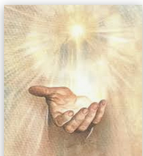
“Whatever will be, will be.”

Slide 33
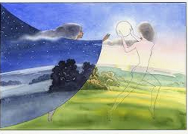
The second traditional image of the future is cyclical,
based on the rhythms of nature,
from the movement of the sun over the heavens
bringing forever the repetition of night and day,

Slide 34
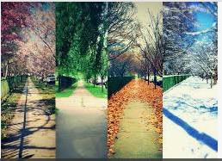
and of the four seasons
—“If winter comes, can spring be far behind?—

Slide 35
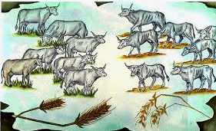
or of the alteration of societies between
“the seven fat years and the seven lean years”
so that nothing gets too bad nor too good,
but cycles endlessly
around a golden mean.

Slide 36
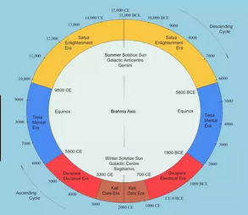
Some seers say that
there are extremely long-cycles of civilizations and eons.

Slide 37
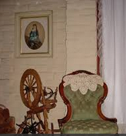
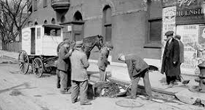
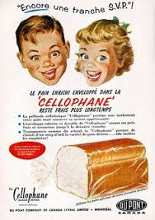
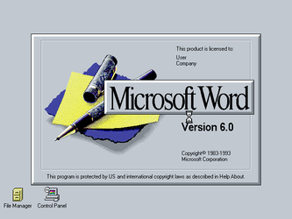
But all these are old-fashioned,
pre-industrial, pre-modern images
that we modern folks can ignore.

Slide 38
The four generic images
are features of all modern and postmodern societies.

Slide 39
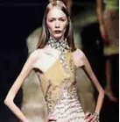
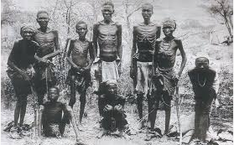
Indeed the existence or nonexistence of these four images
is one way to distinguish between
a developed and
an underdeveloped society.

Slide 40
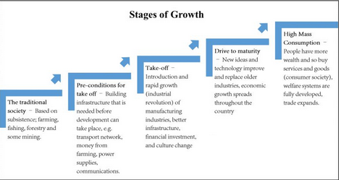
It turns out that the first image,
Continued Growth,
really means Continued Economic Growth,
and is the official image of the future
of all modern or developing nations,
and of all groups and institutions within them.

Slide 41
Against this, there are a vast number of images that say Grow is unsustainable and/or undesirable;
that mindless growth is destructive
of the fundamental processes of life
upon which we all depend,
and/or of basic natural or human values that are essential for a good life, or perhaps for any life at all.

Slide 42
Thus, if Grow continues, society is headed for,
or in the process of,
social, environmental, and perhaps spiritual collapse.

Slide 43
The specific reasons for the collapse
vary from time to time and from community to community,
but endless Growth is often an underlying cause.

Slide 44
Since the late 1980s,
instead of giving my usual “four futures” presentation,
I occasionally would talk about
Surfing the Tsunami of Change.
.

Slide 45
The future is seen as approaching us
in sets of mighty waves
that we need to learn how to “surf”
(that is, utilize their power to go where we want to go,
to the best of our abilities
and within the limits afforded by the waves).

Slide 46
Tragically, the quality of our political discourse is
as though we have our backs to the ocean,
and are arguing over
who forgot to bring the mustard for the hot dogs
while complaining about
the sand in the sandwiches
and ants in the anchovies.

Slide 47
The tsunami are
population,
energy,
economics,
environment,
technology,
culture, and
governance
--and others, depending on
the specific concerns of the audience.

Slide 48
More than 15 years ago,
I reduced those seven or eight tsunami
to four,
and relabeled them
“The Unholy Trinity, Plus One.”
The Three “Persons” of the Unholy Trinity are
the Economy,
Energy, and
the Environment.
Plus One is Governance.

Slide 49
I used the Trinity metaphor because,
like the Holy Trinity,
the Unholy Trinity is “three in one” and “one in three”,
not three separate entities.

Slide 50
However, typically,
one of the three is more “popular” than the other two.
Fads and fashions in the Holy Trinity have
come and gone over the ages.
When the US was founded, God the Father, the Creator
was featured almost exclusively.

Slide 51
Jesus became popular
as a personal friend and advisor
at various times later,

Slide 52
while the Spirit is supreme
during periods of evangelical fervor.

Slide 53
So also with the three members of the Unholy Trinity.

Slide 54
While the economy, the environment, and energy
should be seen as one--parts of the same thing—
typically they are looked at in isolation
with solutions to the problems of one
sought in the actions of the others,
as the problems seemingly rise
one by one.

Slide 55
When I first wrote about them,
energy insufficiency,
as in Peak Oil,
was on everyone’s minds.
That faded,
and remains near zero
in concern now.

Slide 56
Next, the economy loomed large with the Great Recession
but faded with the so-called “recovery”,
as the “debate” over climate change began heating up.
.

Slide 57
For a long time,
most people viewed as
unpatriotic lunacy
my warnings about the inability
of most governments to govern
until suddenly it was on everyone’s lips.

Slide 58
Concern for energy will rise again,
when the destructive fracking boomlet fades,
but all three are always in evidence
to those who have eyes to see and ears to hear.

Slide 59
Both the tsunami and the trinity are my ways of highlighting
the possibilities of collapse and
the urgency of addressing them.

Slide 60
Collapse appears to be challenging Grow
for popularity now.
However, many people realize that
—by sweeping away old institutions,
values, and actors—
collapse provides a wonderful opportunity
for “new beginnings”,

Slide 61
“New beginnings” within a new normal for the four futures
Jim Dator
foresight VOL. 16 NO. 6, 2014, pp. 496-511, © Emerald Group Publishing Limited,
ISSN 1463-6689
and so I now often label it “Collapse/New Beginnings”
to highlight that awareness.

Slide 62
In order to prevent collapse,
and/or recover values
essential to life,
others argue that humans need
to cease doing things
that lead to collapse.
We must restore practices
that were abandoned or forgotten,
and/or adopt new values that will permit us to thrive.

Slide 63
I originally labeled that view, “Conserver Society”
because I was in Canada at the time,
working with the National Science Council of Canada, on a project aimed at
converting the entire nation
from a wasteful Consumer Society
into a sustainable Conserver Society.

Slide 64
I later renamed this image,
“Discipline”,
to broaden the scope beyond environmental concerns
as well as to capture the belief that
restraint and self-discipline that
embraces values and behaviors
other than economic growth
is essential.

Slide 65
Discipline need not mean behavior that is
forced upon people
by an autocrat or dictator
--though this might sometimes be necessary.

Slide 66
Discipline primarily means self-discipline,
similar to what a person agrees to
when joining a religious order
that requires one freely, willingly, and eagerly
to give up certain practices and adopt others
for the greater good of ones’ self and others.

Slide 67
The image of a Transformational Society
has always had two versions,
one is High Tech
and the other is High Spirit.

Slide 68
The high tech version stresses
the transformative power of technologies,

Slide 69
while high spirit reflects religious,
New Age, and other similar assumptions
about the transformative power
of spiritual beliefs and practices.

Slide 70
One way to visualize Transform,
in contrast to mere rapid change,
is the process of metamorphosis
by which a caterpillar
unexpectedly morphs into a butterfly,

Slide 71
or how flowing water
“instantly”
becomes steam when heated to a certain degree,
or ice when the temperature is lowered sufficiently.

Slide 72
None of these changes is “predictable”
from knowledge of the original conditions,
until you have observed them
and come to understand the “hidden” causes.

Slide 73
So also the exact contours of a Transformational future
are beyond our present imagination,
but they are dependent on our actions and inactions now,
and may require our tender attention for a while
even after the details are more apparent.

Slide 74
One version of High Tech Transformation
anticipates that a world of
material abundance with humans, posthumans, transhumans, and artilects
on Earth, Moon, and inner solar system
is potentially imminent.
The timid views and actions of
Grow, Collapse, and Discipline are unimaginative and uninspiring,
they maintain.

Slide 75
Robots, artificial intelligence,
autonomous entities, cyborgs, artilects,
ubiquitous technologies
have already just about taken over
all manual and mental jobs
that once upon a time only humans could do.

Slide 76
New, real jobs
requiring human labor and intelligence
will not emerge
to take the place of the old, necessary jobs
the robots have taken over.

Slide 77
A world
free of meaningless make-work
could also be a world
of great creativity.

Slide 78
Not a perfect world, but
a Dream Society,
a Creative Society
of meaning, plenty, play, and
full unemployment!

Slide 79
Four Generic Images of the Futures
Grow Collapse Discipline Transform

Slide 80
These four futures are used to assess
the futures of entire communities,
as well as of individual institutions
(let’s call them “X”)
within communities.

Slide 81
Extraterrestrial
Global
Environment
The futures of X are influenced
both by factors indigenous to X,
and by exogenous factors--by the broader environment surrounding X.
Government
Suppliers
Competitors
X
Customers
Economy,
Technology
Natural
Artificial
Regional,

Slide 82
At the same time,
the environment of X is influenced by
the features and acts of each of its component Xs.

Slide 83
Thus, it is always necessary
to assess the futures of society as a whole
while assessing the futures of any given institution, community, or process.

Slide 84
It is important to understand that these four are
GENERIC images of the futures.
They are broad, sturdy kettles from which
countless specific expressions of their type bubble out.

Slide 85
When I use the four for teaching
and especially for consulting,
I construct specific images
based on the history
of the institution
I am working with;

Slide 86
with its own understanding of its current condition,
and on the specific content of the four images
as appropriate for and expressed by
the participants and myself.
So the specific description of each future differs accordingly.

Slide 87
Moreover it is important to understand that
these four are IMAGES of the future.
They are beliefs about the future
that to some extent vary
and to some extent persist
over time.

Slide 88
However, nothing is more volatile
than images of the future.
They may seem to be fixed in people’s minds,
but they often are not.

Slide 89
For example,
I was scheduled to give a talk on alternative futures
to a bunch of bankers in Honolulu
on Monday, October 19, 1987.
That turned out to be
Black Monday
and the collapse
of stock markets globally.
No one was able to think about any future
but doom and gloom.

Slide 90
Similarly, the image of the future
of the US and the world held by many Americans
on September 12, 2001
was totally different from what it had been
on September 10 .

Slide 91
The events of one short day changed everything.
What people were prepared to believe
about the future of the US on the 10th
was completely untenable on the 12th,
and vice versa.

Slide 92
If I had given them,
on September 10th,
a scenario of
what happened
on the 11th,
no one would have believed it.
On the 12th,
no one could imagine anything else.

Slide 93
The US flipped
from the “give me liberty or give me death,
don’t tread on me,
land of the free and the home of the brave,”
to people who instead cry out “give me shelter”;
people afraid of their own shadow;

Slide 94
who run in panic shouting
“active shooter!”,
shutting down the Honolulu airport
for a day in June 2019
when a barricade at a TSA checkpoint tipped over
and fell to the floor with a loud bang,

Slide 95
while on January 13, 2018,
many citizens in Hawaii panicked hysterically,
believing that a nuclear missile from North Korea
was on its way because of
a false alarm
that could easily have been found to be false
by any normal person.

Slide 96
So what people worry about,
what drives their fear of collapse
changes frequently,
and thus my specific versions of collapse change too,
both to reflect the latest fear
and to show that earlier reasons for concern often persist
even if they are currently unheeded.

Slide 97
When I began, in the 60s and 70s,
environmental collapse was in the air
—over-population, end of oil,
global famine,
serious air, water, and land pollution,
even climate change
(though, in truth,
some did fear a new ice age
while evidence of global warming
was also becoming apparent).

Slide 98
Then during the 1970s,
the price of oil soared ever upward,
double-digit stagflation persisted,
the economy was on the ropes.
All hope was lost.
But no one worried about the environment anymore.

Slide 99
With the election of
an avuncular movie actor,
voodoo economics
suddenly became the new wisdom,
doing its debt-compounding thing,
and it was suddenly morning in America,
with only atomic annihilation
from the Evil Empires
to worry about.

Slide 100
But the Empires collapsed
suddenly, unexpectedly, peacefully,
by 1990,

Slide 101
and the megatrends and flat worlds
of neoliberal globalization dazzled us,
until we began worrying about the end of oil again
—this time hysterically—
whereupon fracking miraculously appeared
and lured us into complacency
(and increased global warming).

Slide 102
Suddenly, a new, bronzed Messiah
for a New Jerusalem,
birthed in a manger in a grass shack
under a rainbow in Hawaii
(or not)!
Hope abounded for the permanent change
America had needed for so long…., then

Slide 103
segued into
the mother of all collapse scenarios
for some Americans
—the election of a swamp-draining iconoclast
as president of the United States
(who among us predicted that?)—
and stunned the world.

Slide 104
Was the past 75 years just a dream
from which we were rudely awakened?

Slide 105
Is globalism over,
along with the once great and glamorous US,
and perhaps Western Liberalism
(as well as West Coast Liberalism)?

Slide 106
But wait.
Who says this
collapse is bad?
Isn’t America Great again,
and about to get greater still, as it and all other nations,
turn properly inward,
becoming mercantilist, protectionist, populist, nationalistic, patriotic, and righteously religious
as multitudes everywhere devoutly wish?

Slide 107
But think again because the
robotic, artificially-intelligent genie
is out of the bottle,
stealing our jobs
while transporting us
into the Anthropocene Epoch
as Singularity converges in the nick of time
to teach humanity how to surf
the rising tsunami of global change and sea level rise.

Slide 108
One person’s tragedy is another’s triumph,
and we all wipeout in the end.

Slide 109
So, to conclude:
Collapse scenarios
—and not merely “decline” or “restraint”--
should be included whenever alternative futures
are discussed
because

Slide 110
1. Collapse happens.
All nations, communities, institutions, and people
do come to an end,
and it is the duty of futurists to say so, and why.

Slide 111
2. Collapse images of the future exist,
and futurists should not refuse to present
widely-held images
simply because the client doesn’t want to hear them
and the futurist is afraid of losing business.

Slide 112
3. It is good that collapse happens;
that nothing is forever.
One of the first things a futurist should ask a client is
why X should continue to exist, and not shut down.
Clients often can give no good reasons for
the continued existence of X
when asked to think about it.

Slide 113
4. It is also good that collapse happens
because collapse offers the opportunity for new beginnings.
Getting rid of seriously obsolete ways of doing things provides opportunities for new and better things to emerge.

Slide 114
5. And of course the three main reasons
that collapse images must be presented
are the three “Ps”—
Prevent,
Prepare,
Prevail.

Slide 115
To prevent the collapse of X
by being forewarned and forearmed of the possibility;

Slide 116
To prepare for collapse
if it cannot be prevented
so that collapse can occur on the best possible terms
for X and all concerned; and

Slide 117
To prevail.
To enable X to rise from the ashes, and thrive
as New Beginnings.

Slide 118
Thank you!

Slide 119
The evolution of Collapse
and other futures
THE PUBLIC SECTOR FORESIGHT NETWORK Meeting
July 31, 2019
Jim Dator
Hawaii Research Center for Futures Studies
Department of Political Science
University of Hawaii at Manoa
dator@hawaii.edu

