Slide 1
The 2030 Agenda for Sustainable Development: International Follow-up and Review Efforts to Ensure Effective Global Implementation PSFN and FFCol Foresight Day 22 July 2016
J. Christopher Mihm

Slide 2
The Sustainable Development Goals

Slide 3
The 2030 Agenda for Sustainable Development
Integrated and indivisible
Universal
Strong focus on effective governance and the means of implementation (MIA)
Commitment to national reporting and rigorous follow-up and review

Slide 4
Follow-up and Review
National reviews
Regional reviews
Thematic reviews
Global reviews

Slide 5
INTOSAI and the A2030
Centerpiece of the draft INTOSAI Strategic Plan for 2017-22. http://www.intosai.org/news/220416-draft-new-intosai-strategic-plan-2017-22.html
One of the two themes for the Congress this December in Abu Dhabi
INTOSAI in coordination with its partners is developing an audit program for assessing national preparedness
Efforts by INTOSAI regional organizations

Slide 6
Role for Supreme Audit Institutions
The UN General Assembly in resolutions A/66/209 and A/69/228, recognized the key roles that Supreme Audit Institutions can play in helping to ensure the effective implementation and follow-up and review.
We can expect to make valuable contributions to the national, regional, and global implementation and follow-up and review efforts of the SDGs:
1. Support national efforts to build effective, accountable, and inclusive institutions, as called for by SDG 16 which commits each nation to “promote peaceful and inclusive societies for sustainable development, provide access to justice for all and build effective, accountable and inclusive institutions at all levels.”
2. Audit national systems of assessing progress toward meeting national sustainable development goals,
3. Undertake performance audits that examine the economy, efficiency, and effectiveness of key government programs that contribute to specific aspects of the SDGs, and
4. Be models of transparency and accountability in their own internal operations, including auditing and reporting.

Slide 7
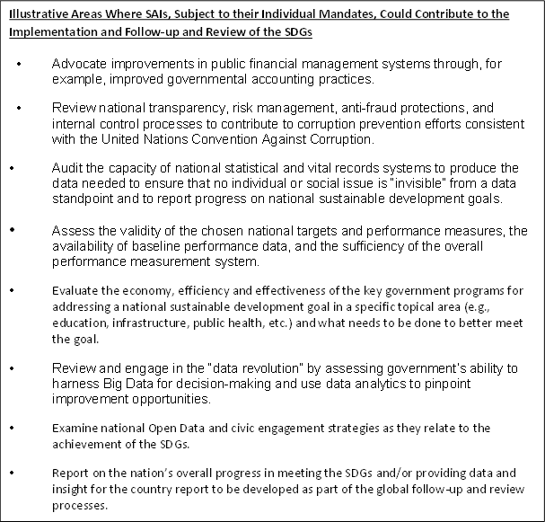
Types of work SAIs could do

Slide 8
Assessing National Preparedness to Implement the SDGs
Selected key focus areas using the U.N. common reporting guidelines for the “Voluntary National Reviews at the HLPF”—High Level Political Forum
Potential key focus areas:
Integration of SDGs into national frameworks
Establishment of sustainable development goals, reporting regimes, and accountability mechanisms
Capacity of national statistical systems to produce data—including disaggregated data

Slide 9
Potential key focus areas, continued
Capacity of the “Center of Government”
Sustainable development plans that link ministries, levels of government, and sectors
Collaborative mechanisms and network management practices
Strategic foresight and risk management at both the enterprise and system levels
“Policy coherence” across the various ways government seeks to achieve results
“Means of implementation” (SDG Goal 17)
Available resources
Public integrity
Service delivery mechanisms (including delivery units)

Slide 10
Potential key focus areas, continued
National follow-up and review plans. How does the nation plan to assess and report on its progress?
Foresight capacity
Evaluation capacity
Roles of stakeholders
Commitment to transparency and public reporting
Role of the SAI
National plans, if any, to participate in the HLPF Voluntary National Reviews

Slide 11
Thank you!

